Slide 1
ADLB Update Recent and Current Adventures with the Asynchronous Dynamic Load Balancing Library
Rusty Lusk
Mathematics and Computer Science Division
Argonne National Laboratory

Slide 2
Outline
Review of what ADLB is
Progress in the context of GFMC
Recent applications other than GFMC
Current implementation activities

Slide 3
Load Balancing
Definition: the assignment (scheduling) of tasks (code + data) to processes so as to minimize the total idle times of processes
Static load balancing
all tasks are known in advance and pre-assigned to processes
works well if all tasks take the same amount of time
requires no coordination process
Dynamic load balancing
tasks are assigned to processes by coordinating process when processes become available
Requires communication between manager and worker processes
Tasks may create additional tasks
Tasks may be quite different from one another

Slide 4
Generic Master/Slave Algorithm
Shared
Work queue
Master
Slave
Slave
Slave
Slave
Slave
Easily implemented in MPI
Solves some problems
implements dynamic load balancing
termination detection (either preemptive or by exhaustion)
dynamic task creation
can implement workflow structure of tasks
Scalability problems
Master can become a communication bottleneck (granularity dependent)
Memory can become a bottleneck (depends on task description size)

Slide 5
The ADLB Model (no master)
Slave
Slave
Slave
Slave
Slave
Shared
Work queue
Doesn’t really change algorithms in slaves
Not a new idea (e.g. Linda)
But need scalable, portable, distributed implementation of shared work queue
MPI complexity hidden here

Slide 6
API for a Simple Programming Model
Basic calls
ADLB_Init( num_servers, am_server, app_comm)
ADLB_Server()
ADLB_Put( type, priority, len, buf, target_rank, answer_dest )
ADLB_Reserve( req_types, handle, len, type, prio, answer_dest)
ADLB_Ireserve( … )
ADLB_Get_Reserved( handle, buffer )
ADLB_Set_Done()
ADLB_Finalize()
A few others, for tuning and debugging
ADLB_{Begin,End}_Batch_Put()
Getting performance statistics with ADLB_Get_info(key)

Slide 7
API Notes
Return codes (defined constants)
ADLB_SUCCESS
ADLB_NO_MORE_WORK
ADLB_DONE_BY_EXHAUSTION
ADLB_NO_CURRENT_WORK (for ADLB_Ireserve)
Batch puts are for inserting work units that share a large proportion of their data
Types, answer_rank, target_rank can be used to implement some common patterns
Sending a message
Decomposing a task into subtasks
Maybe should be built into API

Slide 8
How It Works (Current production version)
put/get
Application Processes
ADLB Servers

Slide 9
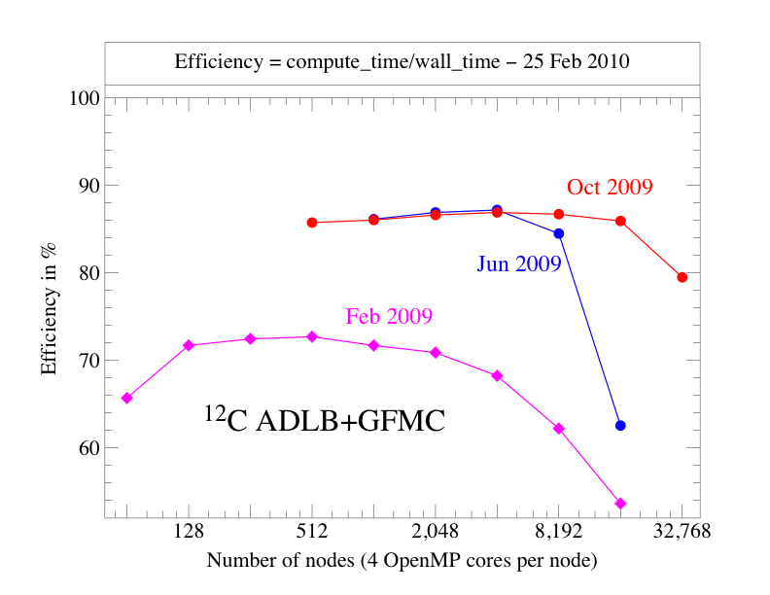
Progress with GFMC

Slide 10
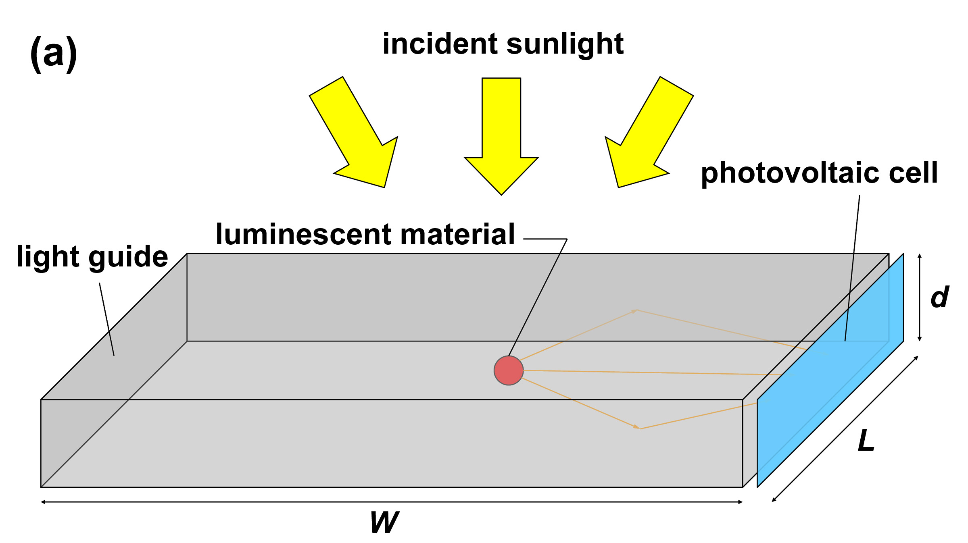
Another Physics Application – Parameter Sweep
Luminescent solar concentrators
Stationary, no moving parts
Operate efficiently under diffuse light conditions (northern climates)
Inexpensive collector, concentrate light on high-performance solar cell
In this case, the authors never learned any parallel programming approach before ADLB (ADLB as high-level programming model)

Slide 11
Two Other Applications
The “Batcher”
Simple but potentially useful
Input is a file of Unix command lines
ADLB worker processes execute each one with the Unix “system” call
Swift substrate
Swift is a high-level workflow description language
ADLB is being tested as an execution engine for Swift programs
Fine granularity needed

Slide 12
Alternate Implementations of the Same API
Single server with one-sided communication among clients
Motivation:
Eliminate multiple views of “shared” queue data structure and the effort required to keep them (almost) coherent)
Free up more processors for application calculations by eliminating most servers.
Use larger client memory to store work packages
Relies on “passive target” MPI-2 remote memory operations
Single master proved to be a scalability bottleneck at 32,000 processors (8K nodes on BG/P) not because of processing capability but because of network congestion.
Have not yet experimented with hybrid version (1-sided, multiple-server)
Completely symmetric (“no server”) threaded version
ADLB code runs in separate thread on each node.
ADLB_Put
ADLB_Get
MPI_Put
MPI_Get

Slide 13
Asynchronous Dynamic Load Balancing
The basic idea:
Shared Memory
Put/get
Work
queue
Application
Threads
ADLB Library
Thread
MPI Communication
with other nodes

Slide 14
Asynchronous Dynamic Load Balancing
The basic idea:
Shared Memory
Put/get
Work
queue
Application
Threads
MPI Communication
with other nodes
ADLB Library
Thread

Slide 15
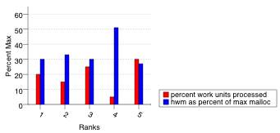
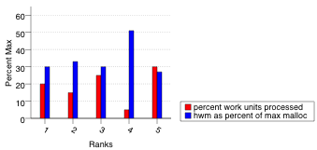
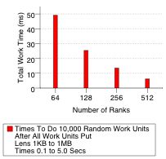
Preliminary Experiments with the Threaded Version
Two kinds of experiments
0-size and 0-length work units to test minimal overheads
random size and length of work units to test load balancing

Slide 16
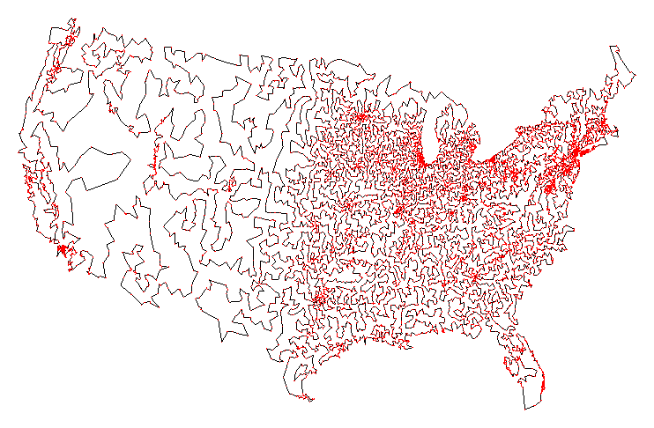
Getting ADLB
Web site is http://www.cs.mtsu.edu/~rbutler/adlb
To download adlb:
svn co http://svn.cs.mtsu.edu/svn/adlbm/trunk adlbm
What you get:
source code (multiple versions)
configure script and Makefile
README, with API documentation
Examples
Sudoku
Batcher
Batcher README
Traveling Salesman Problem
To run your application
configure, make to build ADLB library
Compile your application with mpicc, use Makefile as example
Run with mpiexec
Problems/complaints/kudos to {lusk,rbutler}@mcs.anl.gov

Slide 17
Conclusions
The Philosophical Accomplishment: Scalability need not come at the expense of complexity
The Practical Accomplishment: Multiple uses
As high-level library to make simple applications scalable
As execution engine for
complicated applications (like GFMC)
higher-level “many-task” programming models

Slide 18
The End

