Slide 1
Statistical Theory of Nuclear Reactions
UNEDF SciDAC Annual Meeting
MSU, June 21-24, 2010
Goran Arbanas (ORNL)
Kenny Roche (PNNL)
Arthur Kerman (MIT/UT)
Carlos Bertulani (TAMU)
David Dean (ORNL)

Slide 2
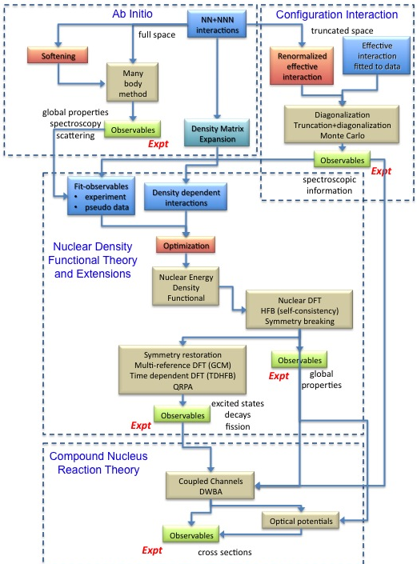
HPC numerical
simulation of
formal theories of
statistical nuclear
reactions

Slide 3
Year 5 Progress Report
Year 5 Reaction Deliverable #55:
  “Examine energy-dependence of eigensolutions in the expansion for the KKM theory.”
Year 5 Progress Report:
  Prototyped energy dependence in KKM:
    Intel MKL implementation of complex symmetric eigensolver on 12 cores
  Massively parallel code in “ensemble” eigensolver of complex symmetric matrices (K. Roche).
    In the meantime: loop through energies on the parallel code.
Related HPC contribution:
  Massively Parallel eigensolver for large (ensembles) of complex symmetric matrices

Slide 4
Why KKM?
A framework based on Feshbach’s projection operators
Central result:
  T = T_{background} + T_{resonant} = T_{average} + T_{fluctuating}
A foundation for derived statistical theories:
  Kerman-McVoy
    Designed for two step processes like A(d,p)B*, B*→A+n
    Could be used for statistical (d,p) reactions at FRIB
  Feshbach-Kerman-Koonin (FKK)
    Multistep reactions, used for nuclear data analysis
Similar expressions were derived later by other methods

Slide 5
Physical picture
P
PHQ
Q
doorway
compound
E
…
d
dHq
q
continuum
bound
Q
P
d
q

Slide 6
Feshbach’s projection operators
Two-potential formula yields

Slide 7
KKM subtraction
Kawai, Kerman, and McVoy
Ann. of Phys. 75, 156 (1973)
Energy averaging of
the T-matrix yields this
expression for optical
potential and opt.wave-f.
(for Lorentzian averaging)
Use H_{opt} to
rewrite Eq. (3)

Slide 8
KKM Fluctuation T-matrix
Two-potential formula yields

Slide 9
Expand the T-matrix by eigenfunctions
This E-dependence now
treated explicitly.
Lorentzian weight function width .

Slide 10
Preliminary Results:
Eigenvalues/vectors | Average Ratio | SQRT(Variance)
E-independent | 0.0037 | 0.0053
E-dependent | 0.0042 | 0.0049
Computation parameters:
Eigenvalues/vectors computed at 100 energies spanning 18-22 MeV
1600 equidistant Q-levels
40 channels
20 equidistant radial points where H_{PQ} set to a Gaussian- distributed random interaction
E = 20 MeV
100 E’ points for Lorentzian averaging between 18 and 22 MeV
Lorentzian averaging width I = 0.5 MeV
s-wave only
Strongly overlapping resoances

Slide 11
Test approximations in KKM derivation
The E-dependence makes E-averaging more accurate
Random Phase Hypothesis
Preliminary results are
analyzed.

Slide 12
HPC progress report (by K. Roche)

Slide 13
Year 5 plan
Complete parallel KKM with E-dep. eigenvalues/vectors
Test approximations in derivation of KKM cross sections
Publish the KKM work (including the work on doorways)

