Slide 1
SciDAC Reaction Theory
Ian Thompson
Lawrence Livermore National Laboratory, P. O. Box 808, Livermore, CA 94551
This work performed under the auspices of the U.S. Department of Energy by
Lawrence Livermore National Laboratory under Contract DE-AC52-07NA27344
LLNL-PRES-488272

Slide 2
Part of the UNEDF Strategy
Ground
State
Effective
Interaction
Excited
States

Slide 3
1: UNEDF project: a national 5-year SciDAC collaboration
Target
A = (N,Z)
Ground state
Excited states
Continuum states
Structure Models
Methods: HF, DFT,
RPA, CI, CC, …
Transition
Density [Nobre]
KEY:
UNEDF Ab-initio Input
User Inputs/Outputs
Exchanged Data
Related research
UNEDF:
V_{NN}, V_{NNN}…
V_{eff} for
scattering
Transition Densities
Folding
[Escher, Nobre]
UNEDF Reaction Work
E_{projectile}
Transition Potentials
Deliverables
Coupled
Channels
[Thompson, Summers]
Hauser-
Feshbach
decay chains
[Ormand]
Partial
Fusion
Theory
[Thompson]
Residues
(N’,Z’)
Inelastic
production
Compound
emission
Two-step
Optical
Potential
Elastic
S-matrix
elements
Neutron escape
[Summers,
Thompson]
or
Resonance
Averaging
[Arbanas]
Preequilibrium
emission
V_{optical}
Global optical
potentials
Optical Potentials
[Arbanas]

Slide 4
Promised Year-5 Deliverables
Investigate reactions in light nuclei using NCSM with RGM:
  Benchmark n-⁸He, and n-⁹Li scattering.
  Investigate p-⁷Be and ³H+⁴He scattering and capture reactions.
  Use two-, three-, and four-body transition densities for A=3,4 nuclei.
  Development of three-body transition density calculation for A>4.
Consistent nucleon-nucleus optical potentials within elastic and all inelastic and transfer.
Fold QRPA transition densities with density-dependent and spin-orbit forces. Include effective masses, and direct charge-exchange.
Calculate and investigate effects of exchange nonlocalities.
Systematic generation of optical potentials for a wide range of near-spherical nuclei.
First nucleon-nucleus calculations with deformed QRPA transition densities.
Examine role of optical-potential L-dependences & non-localities in direct reaction calculations.
Examine energy-dependence of eigensolutions in the expansion for the KKM theory

Slide 5
Delivered in Year-5 up to Q2
Funding Delays:
  LLNL reaction funding cut to 50% for Year-5, but not even that 50% all arrived.
  All received funding used for postdoc (Nobre) up to April 2011 + this meeting.
Deliverables:
Erich Ormand:
Reactions in light nuclei using NCSM with RGM
Implemented but not fully researched
Effective masses for scattering
Systematic generation of optical potentials for a wide range of near-spherical nuclei.
Spin-off for PhD topic at MSU:
Examine role of optical-potential L-dependences & non-localities in direct reaction calculations.
Goran Arbanas:
Examine energy-dependence of eigensolutions in the expansion for the KKM theory
Not Implemented
Consistent nucleon-nucleus optical potentials
Fold QRPA transition densities with density-dependent, spin-orbit forces & charge exchange.
First nucleon-nucleus calculations with deformed QRPA transition densities.
Calculate and investigate effects of exchange nonlocalities.

Slide 6
Three Talks on Reaction Theory
Ian Thompson & Gustavo Nobre
A Microscopic Reaction Model using Energy Density Functionals
Goran Arbanas
Local Equivalent Potentials
Statistical Models of Nuclear Reactions
Erich Ormand (for Petr Navratil & Sofia Quaglioni)
Ab-initio Calculations of Light Ion Reactions:
  Investigation of p-⁷Be scattering & capture reactions

Slide 7
A Microscopic Reaction Model using
Energy Density Functionals
Performance Measures x.x, x.x, and x.x
Ian Thompson & Gustavo Nobre
Prepared by LLNL under Contract DE-AC52-07NA27344

Slide 8
Outline of Coupled-Channels Calculations
Mean-field HFB calculations using SLy4 Skryme functional
Use (Q)RPA to find all levels E*, with transition densities from the g.s.
Structure calculations for n,p + ^{40,48}Ca, ⁵⁸Ni, ⁹⁰Zr and ¹⁴⁴ Sm
Fold transition densities with effective n-n interaction: Transition Potentials
Couple to all excited states, E* < 10, 20, 30, 40 MeV
Find what fraction of σ_{R} corresponds to inelastic couplings: more states, larger σ_{R}, until all open channels are coupled
Couple to all pickup channels leading to deuteron formation
d

Slide 9
Inelastic Convergence
Coupling to more states gives larger effect
Convergence appears when all open channels are coupled
σ_{R}/σ_{OM}=38%
Protons as projectile
For reactions with protons as projectile, inelastic convergence is achieved with less couplings due to the Coulomb barrier.
σ_{R}/σ_{OM}=39%
σ_{R}/σ_{OM}=41%

Slide 10
Coupling Between Excited States
Coupled-channel should (in principle) consider explicitly all possible couplings
Different transferred angular momenta are possible for the same pair of states:
|J_{i}-J_{f}| ≤ L ≤ J_{i}+J_{f}
Expressions for transition densities are much more complex and time consuming
g.s.
# of Transitions (CPU time) | E* < 10 MeV |  | E* < 20 MeV |  | E* < 30 MeV |  | E* < 40 MeV
From g.s. only | 37 | (13.9 s) | 217 | (26.1 s) | 557 | (49.7 s) | 1037 | (83.0 s)
L_{max} = 2 | 170 | (29.5 s) | 4825 | (9 min) | 28597 | (53 min) | 95371 | (3 h)
L_{max} = 4 | 328 | (55.0 s) | 9774 | (23 min) | 60479 | (2.26 h) | 205292 | (~ 8h)

Slide 11
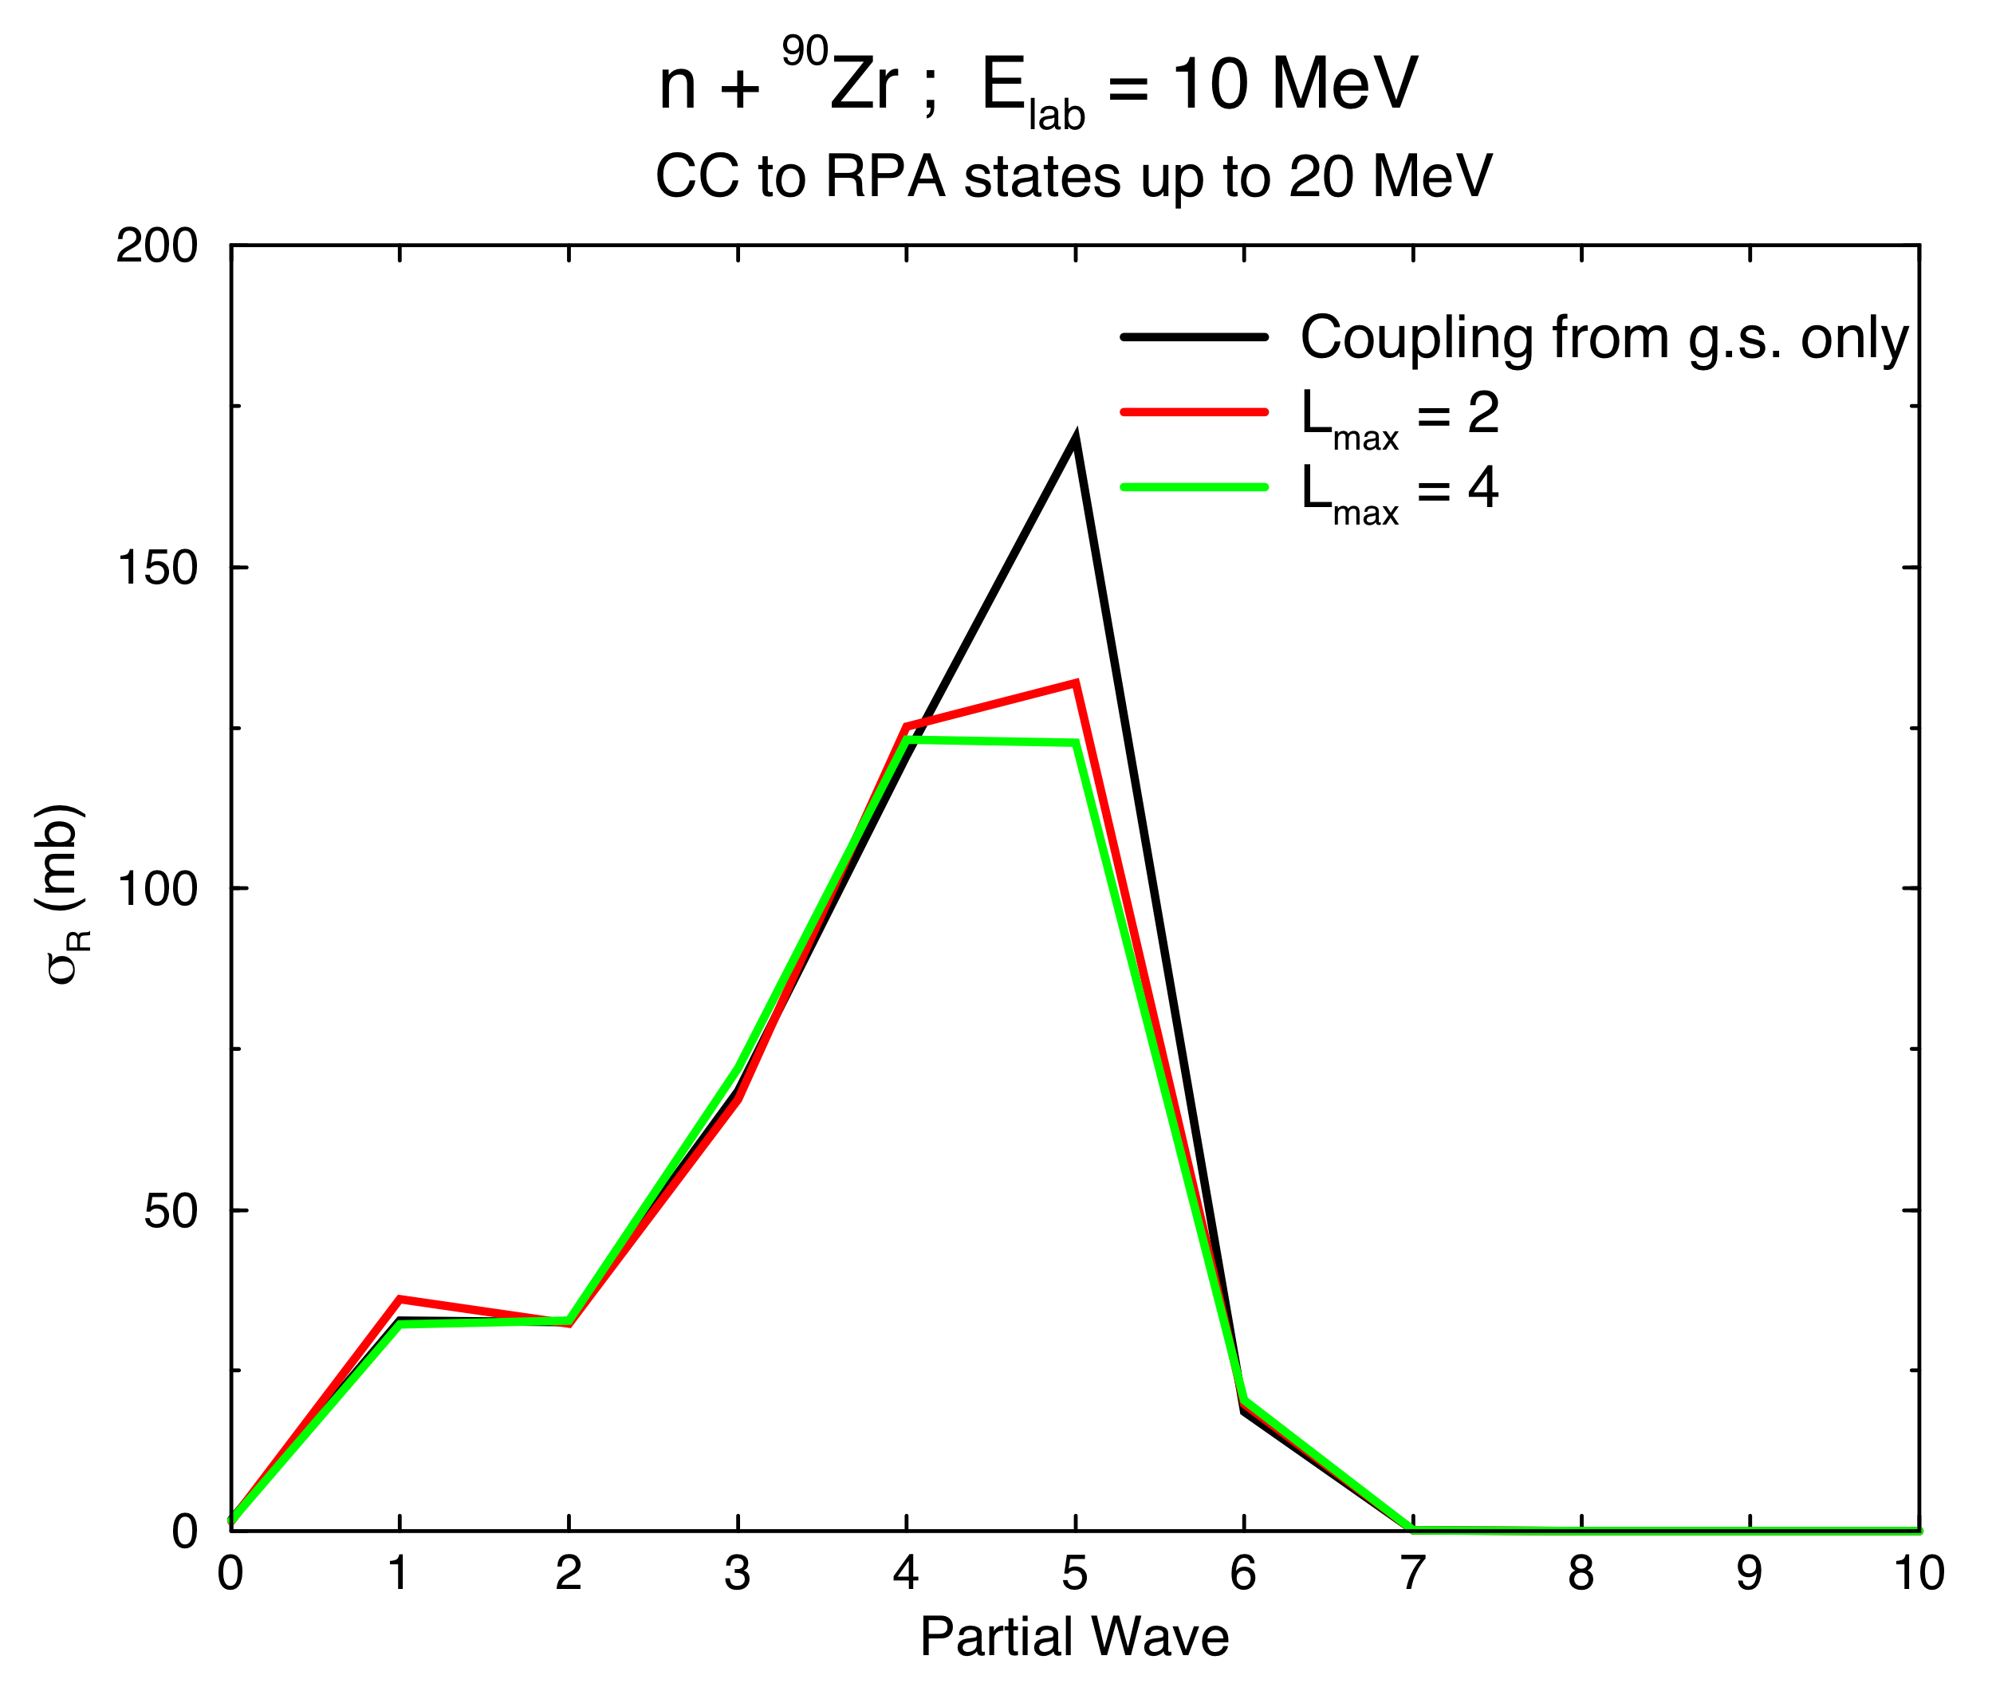
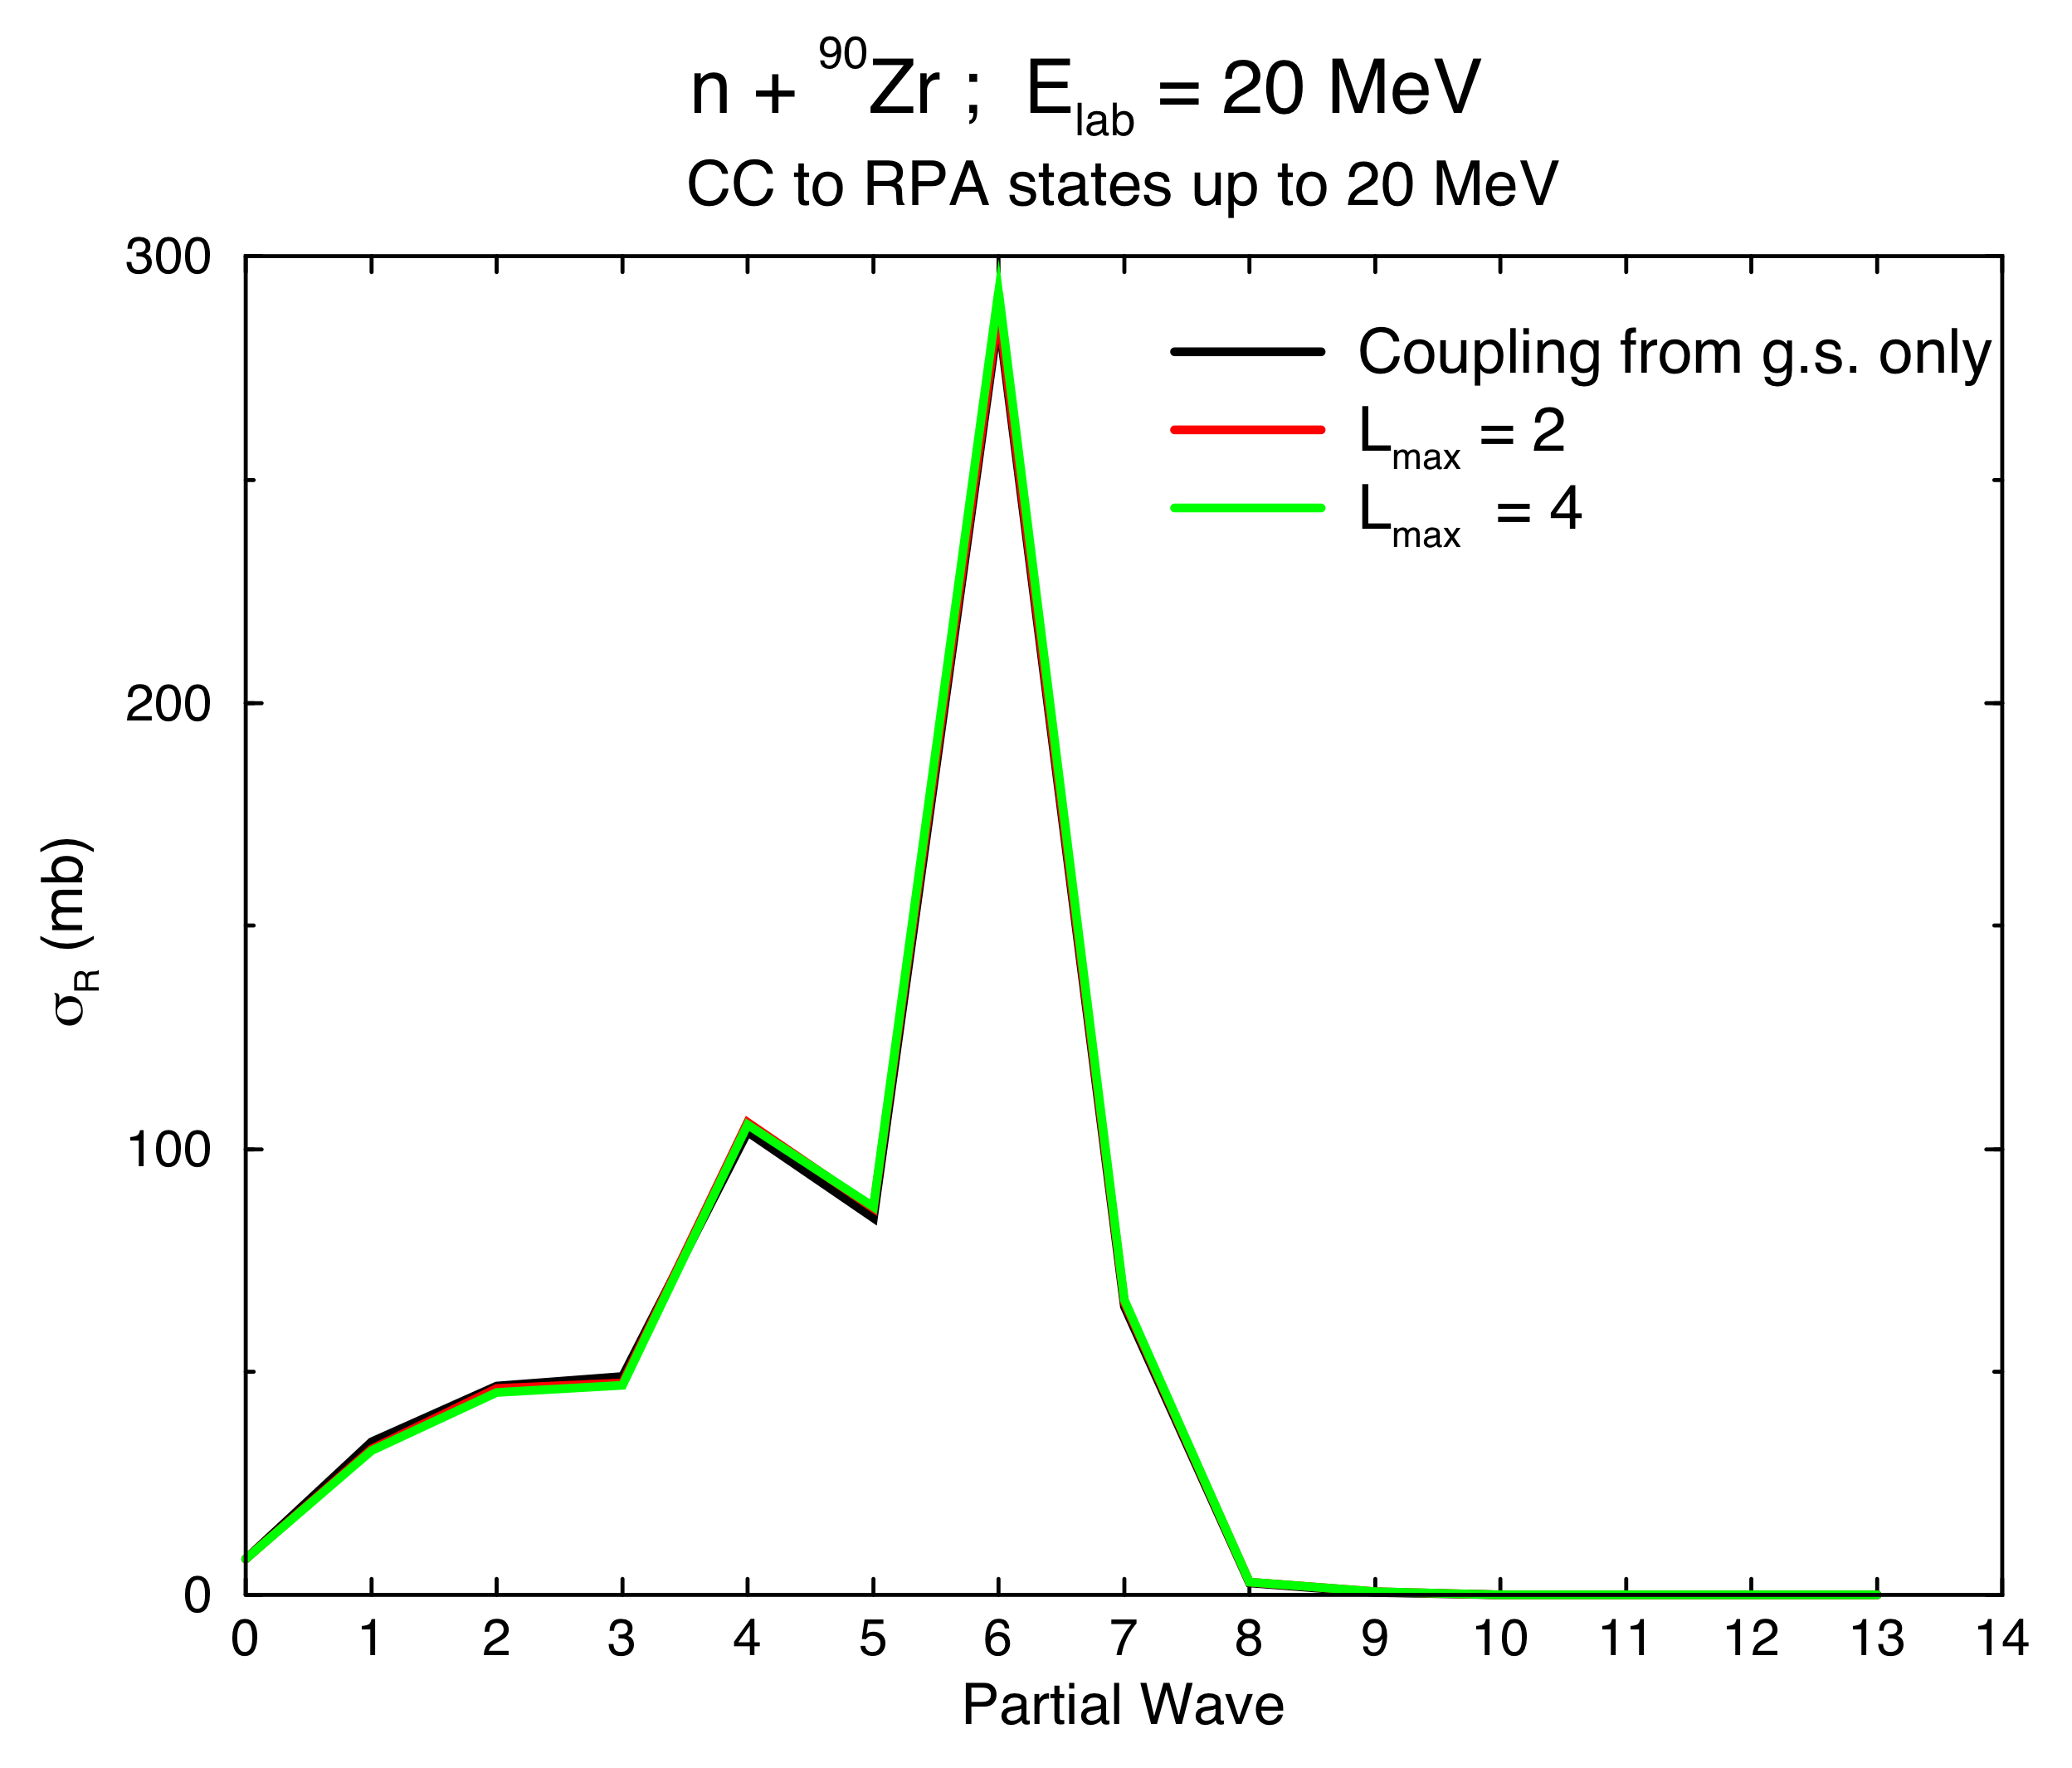
Coupling Between Excited States
At not too low energies:
  Individual cross-sections change very little, except for some few states: up to 20%
  Overall sum of reaction over states remains the same
  Supports the concept of “doorway states”
g.s.
G. P. A. Nobre et al. Proceedings of the International Nuclear Physics Conference (INPC) 2010,
arXiv:1007.5031

Slide 12
Nonelastic Cross Sections for Different Reactions (E_{lab} = 30 MeV)
Phenomenological Optical Model
Inelastic and pick-up channels account for all reaction cross sections
Inelastic couplings only
Inelastic + Transfer
Inelastic + Transfer with non-orthogonality

Slide 13
Comparison with Experimental Data
Good description of experimental data!
Inelastic and pick-up channels account for all reaction cross sections
Inelastic convergence when coupling up to all open channels

Slide 14
Comparison with Experimental Data
Good description of experimental data!
Inelastic and pick-up channels account for all reaction cross sections
G. P. A. Nobre, F.S. Dietrich, J. E. Escher, I. J. Thompson, M. Dupuis, J. Terasaki and J. Engel
Phys. Rev. Lett. 105, 202502 (2010)

Slide 15
Summary of Results at E_{lab} = 30 MeV
Targets
⁴⁰Ca, ⁴⁸Ca, ⁵⁸Ni, ⁹⁰Zr, ¹⁴⁴Sm
Phenomenological Optical Model
Inelastic couplings only
Inelastic + Transfer
Inelastic + Transfer with non-orthogonality
With all couplings, calculations agree with experimental data
G. P. A. Nobre, F.S. Dietrich, J. E. Escher, I. J. Thompson, M. Dupuis, J. Terasaki and J. Engel
Phys. Rev. Lett. 105, 202502 (2010)

Slide 16
Elastic Angular Distributions
Provide complementary information on reaction mechanisms
Are sensitive to the effective interaction used
Results will be shown in paper being prepared for submission to PRC
Our approach predicts a variety of reaction observables.
Data provide constraints on the ingredients.
Density-dependent effective interaction:
Resulting coupling potentials improve large-angle behavior, still need improvements for small angles.
Work in progress to treat and then test UNEDF Skyrme functionals.

Slide 17
Promise Year-5-End Deliverables
Investigate reactions in light nuclei using NCSM with RGM. Some of:
  Benchmark n-⁸He, and n-⁹Li scattering.
  Investigate ³H+⁴He scattering and capture reactions.
  Use two-, three-, and four-body transition densities for A=3,4 nuclei.
  Development of three-body transition density calculation for A>4.
LLNL nucleon-nucleus calculations:
Determine deuteron optical potentials, including deuteron breakup
Folding of density-dependent, spin-orbit and charge-exchange forces
Effects of Skyrmian effective masses in scattering
UNC collaboration: generate & compare deformed-QRPA transition densities (?)
Support MSU student on optical-potential L-dependences & non-localities in direct reaction calculations.
Arbanas:
Examine energy-dependence of eigensolutions in the expansion for the KKM theory

