Slide 1
J. Pei, W. Nazarewicz, A. Kruppa
Annual UNEDF Meeting, MSU, 6/21/2011
Treatment of HFB Resonances
University of Tennessee
Oak Ridge National Lab

Slide 2
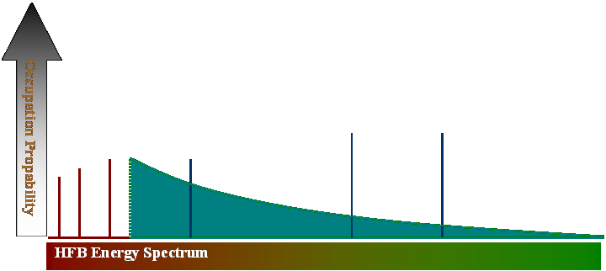
HFB Quasiparticle spectrum
BCS
HFB
Occupation numbers
HFB deep-hole states become resonances
Continuum coupling becomes essential for weakly bound nuclei
Properly treat continuum is essential for QRPA
-λ
Disc.

Slide 3
HFB Quasiparticle spectrum
In the complex k plane
These resonances are observable in experiments; widths depend very much on the pairing interaction; unique in HFB theory beyond BCS description
N.Michel, et al
Identify resonance states that have the complex energy: E-iΓ/2 (widths); and purely scattering states are integrated over the contour.

Slide 4
HFB Strategy
Diagonalization on single-particle basis
Direct diagonalization on box lattice (e.g. B-spline)
Very expensive; so many discretized continuum states
Madness-HFB strategy:
->initial HO basis
->Hamiltonian matrix
->diagonalization
->new eigenvalues and vectors
->Convolution(update basis)
->box boundary(mask)
Hybrid-HFB strategy:
box solutions+deep-hole resonances+high energy continuum states

Slide 5
Box solutions
In the box solution, also called L² discretization, the continuum is discretized into finite states, with very good accuracy compared to exact treatments.
Even with this method the resonance widths can be calculated precisely, compared to the complex scaling method.
HFB-AX generates very dense quasiparticle spectrum, provides a high resolution for continuum and resonance states.
For example, about 7000 states in a 40×40 fm box.
70Zn

Slide 6


High energy continuum states
High-energy approximation (local density approximation)
This approximation works for HFB-popov equation for Bose gas;
works for Bogoliubov de Gennes equations for Fermi gas.
J. Reidl, A. Csordas, R. Graham, and P.Szepfalusy, Phys. Rev. A 59, 3816 (1999)
X.J. Liu, H. Hu, P.D. Drummond, Phys. Rev. A 76,043605 (2007)
We follow this approximation for Skyrme HFB.
quasiparticle spectrum
HF energy
Derivatives of effective mass, spin-orbit terms omitted for high energy states

Slide 7

Continuum to observables
Transform from the p-representations to the integral in terms of energy

Slide 8
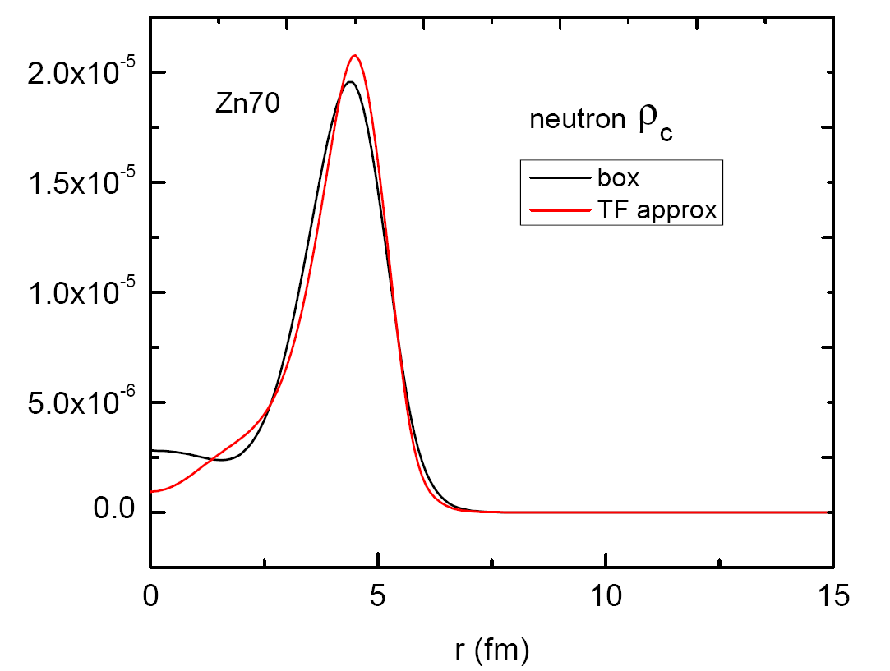
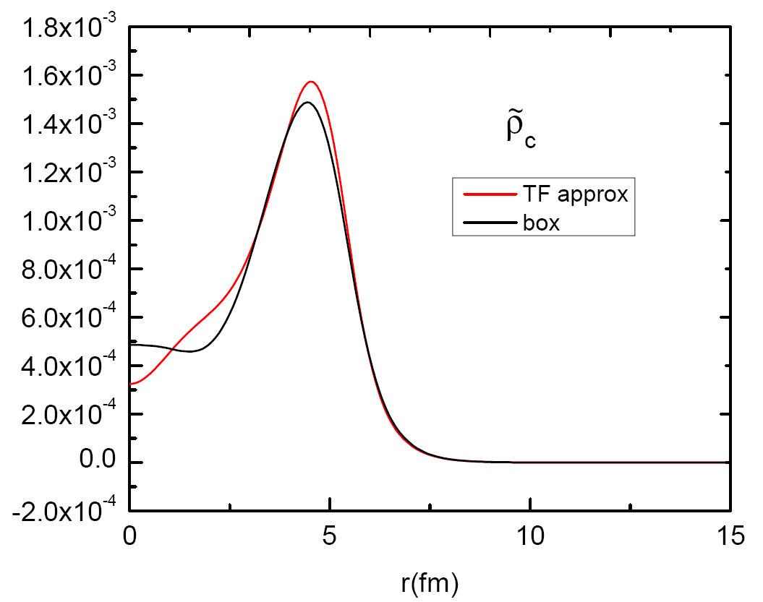
Continuum to observables
Contributions from 40 to 60 MeV
  Local density approximation
  Box solution from HFB-AX
What we see:
Generally the two methods agrees with each other;
The distributions are very similar for the three kind of densities, and this depends on the pairing potential;
Continuum significantly impacts the pp channel.

Slide 9
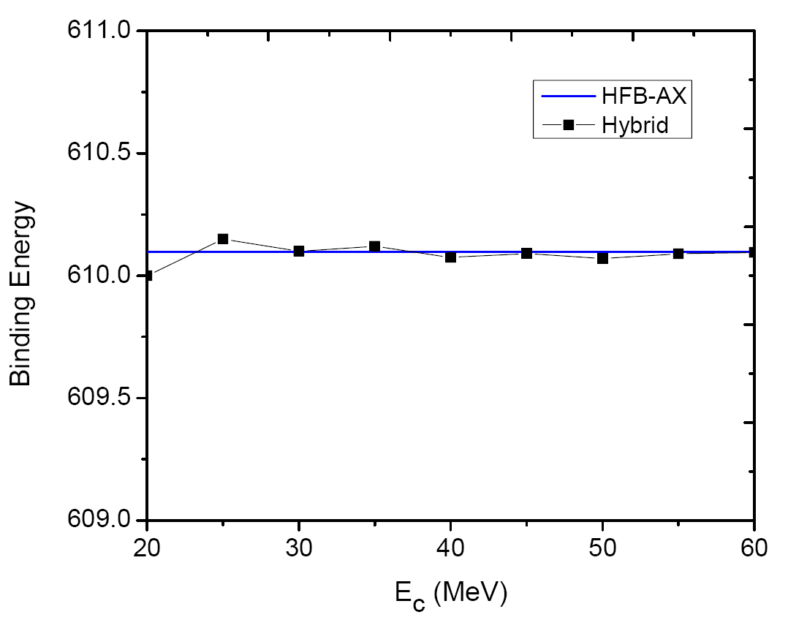
Hybrid HFB
Test the local-density approximation
Assume the continuum coupling is very weak for deep-hole states
Test for Zn70 neutrons
Similar to pairing regularization method

Slide 10
HFB resonances
Continuum level density
General formulas for resonance widths:
Hamilton without interaction
With the Green function method:
Breit-Wigner shape for resonances

Slide 11
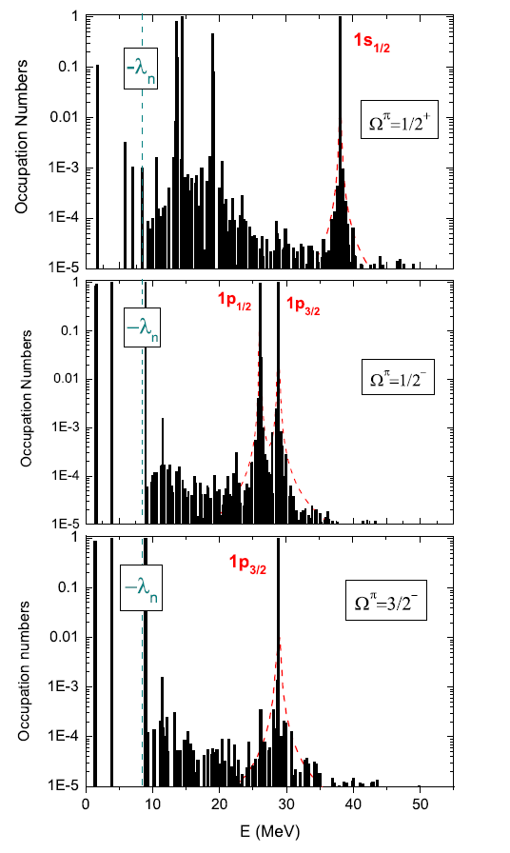

Smoothing-Fitting method
Occupation probability and continuum level density
H. Oba, M. Matsuo, PRC 80, 02430, 2009
Occupation probability is related to the continuum level density, which corresponds to the Breit-Wigner shape

Slide 12
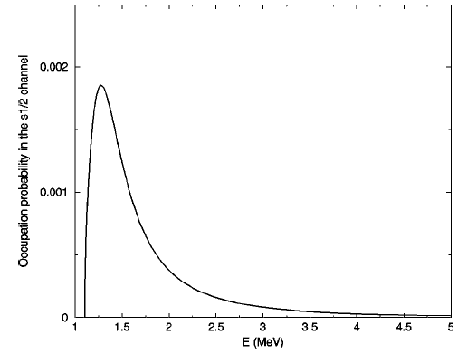
Smoothing-fitting method
Straightforward smoothing-fitting method to extract the widths
Strutinsky smoothing with a Lorentz function
Then we do fitting:
Total occupation
Smoothed B-W
A.T. Kruppa, K. Arai, PRA 59,3556 (1999).
However, resonances near thresholds do not have a B-W shape
Advantages: Works for resonances in deformed nuclei; precision can be improved using a large box size
M. Grasso,PRC 64, 064321, 2001

Slide 13
Stabilization Method
Widely used in atomic physics
Has been applied to single particle resonances
3-body resonances (A.Kruppa)
We applied for the first time to quasiparticle resonances
S.G. Zhou, J. Meng, P. Ring, 2009

Slide 14

Stabilization method
The main idea is to get resonance widths from the box-size dependence of quasiparticle energies
⁷⁰Zn
Spectrum got by HFBRAD solutions with different box sizes
Phase shift:
Continuum level density:
V.A. Mandelshtam, H.S. Taylor, V. Ryaboy and N. Moiseyev, PRA 50, 2764 (1994)

Slide 15

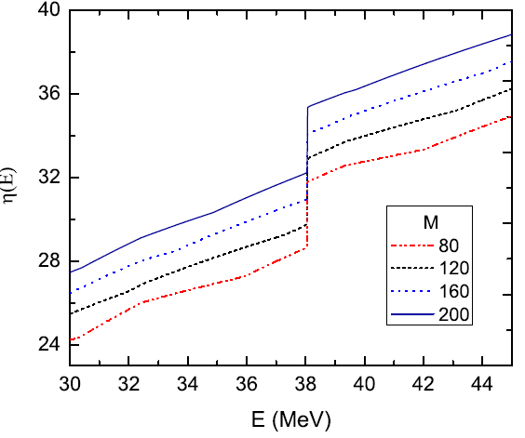
Stabilization method
Calculate the phase shift
Precision depends on two things:
The step size and the step numbers M
Fitting with resonance phase shift and background
In principle, we can get very accurate results, but it can be expensive

Slide 16

Fermi Golden rule
Assume the paring coupling can be treated perturbatively
Solve the scattering wavefunction
Asymptotic form at large distances
A. Bulgac, Preprint FT-194-1980; nucl-th/9907088
However, in some calculations, the FG rule is not precise.

Slide 17
Inapplicability of FG rule
With the volume and surface pairing, two scattering functions a, b
The overlap is too sensitive to the small changes in u_{0E} to give reliable widths, in the case of surface pairing.
overlap

Slide 18
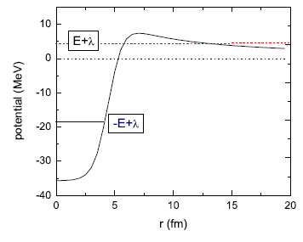
Width results
comparison (widths: keV)
Special narrow reonance (1d_{5/2})
Fermi-golden rule doenst work
Resonance-like solution for the upper component
It is difficult for the stabilization method to calculate widths of extremely narrow resonances
Also happens in neutron states with centrifugal barrier

Slide 19
Weakly-bound Ni isotopes
continuum contribution from 30 to 60 MeV
Ni88
Continuum contribution increases as nuclei close to the drip line
Continuum contribution depends very much on the pairing interaction

Slide 20
Weakly-bound Ni isotopes
Resonance widths (keV) of 90Ni
For example, 1p_{3/2} in Ni isotopes: 25.9 keV (N=58), 28.2 keV (N=60), 30.8 keV (N=62)
Widths increase as nuclei close to the drip line

Slide 21
Summary
local-density approximation:
Works for high energy continuum states.Hybrid HFB strategy can greatly
reduce computational costs; will be very useful for optimizing Madness-
HFB. It also demonstrates that box solutions have very good precision,
and can be used for continuum-QRPA.
Stabilization method:
Produce reliable widths except for very narrow resonances, slightly overestimate the widths by 10%. Provides an alternative way to study continuum and resonances without solving the scattering wavefuntions
Drip-line isotopes:
HFB resonance widths are increasing as nuclei close to drip-lines, which is consistent with that high-energy continuum contributions are also increasing.

Slide 22
Thanks for your attention!

