Slide 1
UNEDF1 Energy Density Functional
M. Kortelainen, J. Moré, J. McDonnell, W. Nazarewicz, P.-G. Reinhart, J. Sarich, N. Schunck. M. V. Stoitsov, S. Wild
Lawrence Livermore National Laboratory, P. O. Box 808, Livermore, CA 94551
This work performed under the auspices of the U.S. Department of Energy by Lawrence Livermore National Laboratory under Contract DE-AC52-07NA27344
UCRL-XXXX-12345

Slide 2
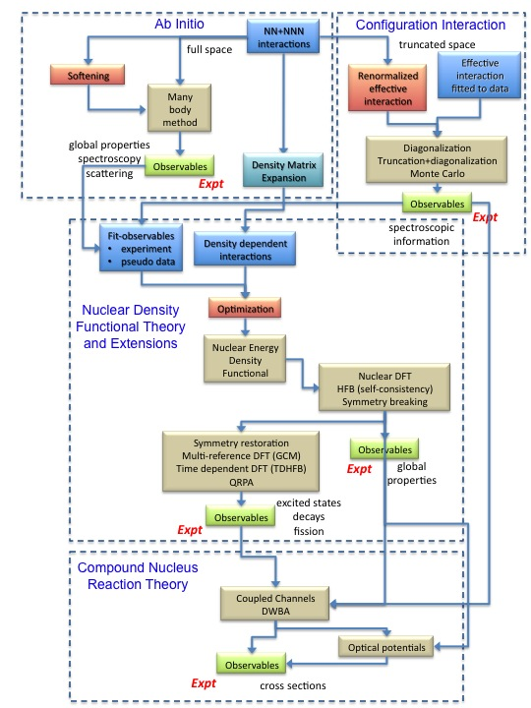
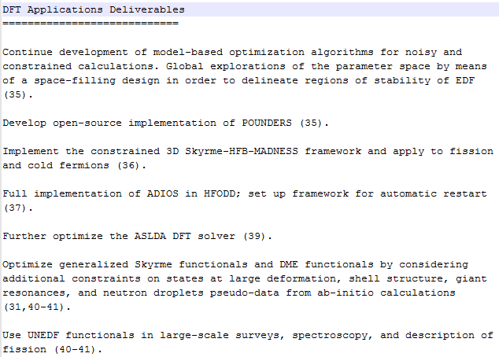
POUNDers
HFBTHO
HFODD

Slide 3
Optimizing Skyrme Functionals
UNEDF1 Energy Density Functional

Slide 4
Practitioner’s DFT in a nutshell
From
last year
Nucleus as a system of independent particles in an ‘optimized’ mean-field
Energy of the nucleus = integral over space of energy density
Energy density = functional of the density matrix
From effective NN interaction at HF approximation: zero-range force = functional of local density – finite-range = functional of non-local density)
Most standard: Skyrme functional (based on the Skyrme force)
Practical considerations:
ED breaks symmetries of the nuclear interaction: deformation, pairing, etc.
Non-linear integro-differential system of equations: computer code
Must add pairing functional treated at the HFB approximation (replace particles by q.p.)
with:

Slide 5
Free Parameters in Skyrme DFT
From
last year
Skyrme functional:
13 constants (12 C_{t} + density dependence γ) not given by theory: must be fitted on some data
Types of data:
Nuclear matter: E/A, K, a_{sym}, M*, etc.
Finite nuclei: masses, radii, separation energies, SO level splitting, OEM differences, 2+ energies in even nuclei, J^{π} in odd nuclei, etc.
A few more parameters to describe pairing (typically 2)
Typical strategy: use NM and spherical doubly-magic nuclei at HF level:
Cheap calculations + leading terms of the functional…
… but no constraint on symmetry-breaking effects
Isoscalar, t = 0
Isovector, t = 1
volume
tensor
spin-orbit

Slide 6
Optimization: Our Strategy
HFB level including deformed nuclei
Parameters of the pairing functional are optimized on the same footing as those of the mean-field
No multi-step minimization
Full symmetry-breaking during optimization: particle-number, rotational invariance
No center of mass correction: 100% DFT picture
CM comes from writing down hamiltonian in intrinsic frame
CM will still need to be fixed somehow, but no need to take the standard form
Poses problem in Fission, fusion
Pairing interaction: surface-volume with 2 parameters (pairing strength for neutrons and protons)
Express all volume coupling constants (including power of density dependence) as function of NM parameters to obtain reliable estimates of CC
HFB+LN calculations in HO basis of 20 shells using HFBTHO

Slide 7
Optimization: Summary
12 parameters fit ( kept fixed for numerical reasons)
115 data points including 28 spherical masses, 28 r.m.s. radii, 44 deformed masses, 4 fission isomer excitation energies, and 8 OEM points (4 + 4)
Starting point: SLy4
Emphasis on heavy (A > 100)
deformed nuclei: where DFT
works best

Slide 8
Results: UNEDF1 parameter set
UNEDF1 Energy Density Functional

Slide 9
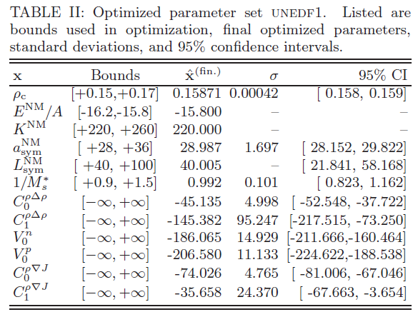
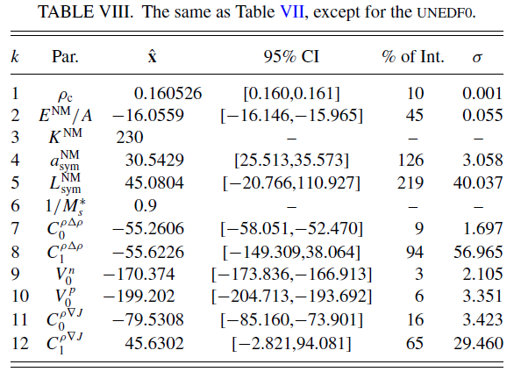
UNEDF1 vs. UNEDF0
UNEDF0
UNEDF1
Some NM properties at the boundaries
Isovector surface coupling constants poorly constraints
Effective mass equal to 1 (nearly)

Slide 10
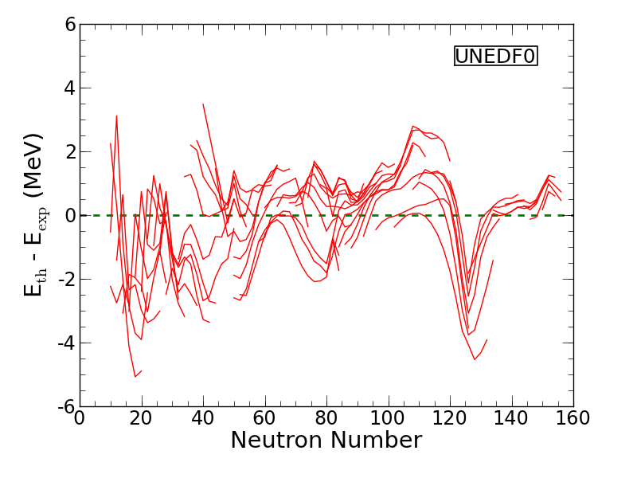
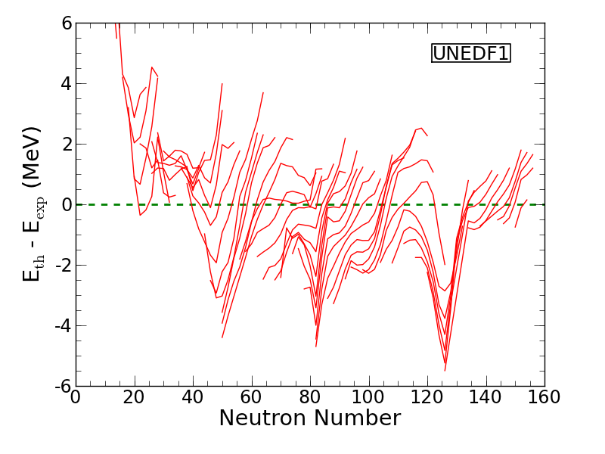
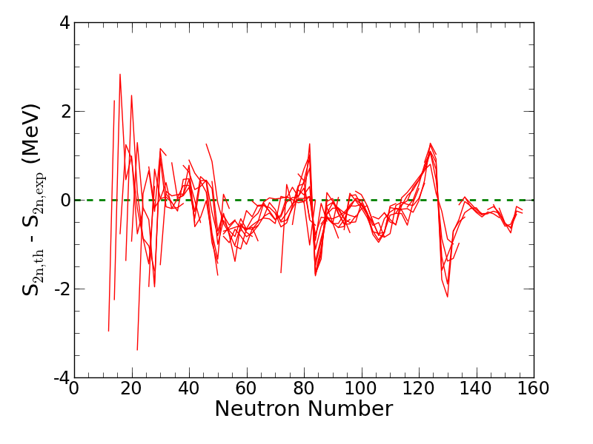
Validation (1/4) Global Validation
Improvement…!
Lack of constraint on center of mass

Slide 11
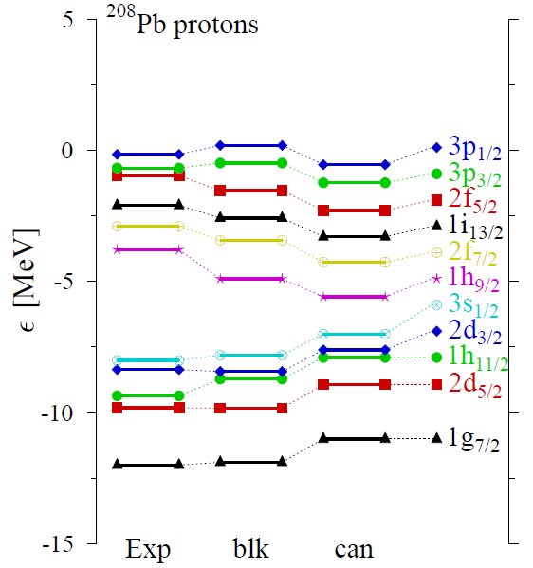
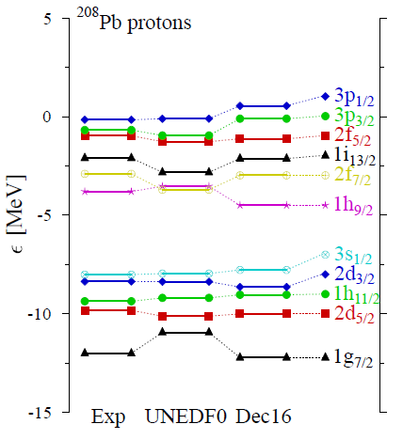
Validation (2/4) Single-particle Structure
See following talk by
M. Stoitsov
UNEDF1
Canonical spectrum ≠ blocked spectrum
Importance of using the right observables in parameter optimization
Slight improvement (not very significant) for s.p. energies with UNEDF1

Slide 12
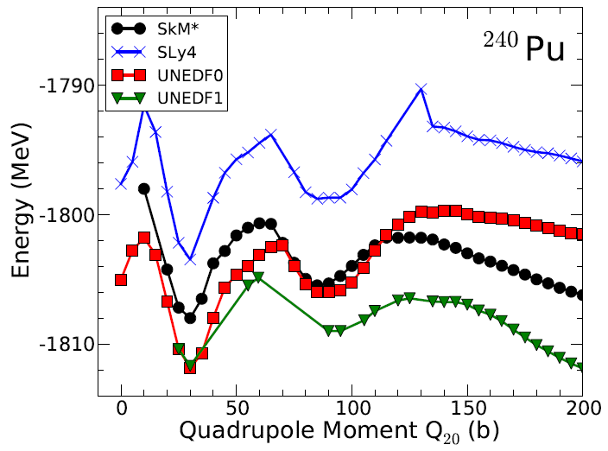
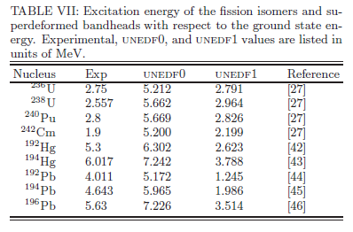
Validation (3/4) Fission Barriers

Slide 13
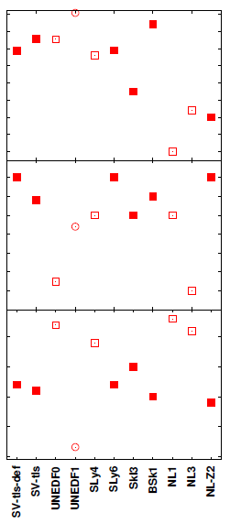
Validation (4/4) LDM Parameters
Bulk surface parameters of Skyrme functionals poorly constrained, but have huge impact on deformation properties
Extract LDM parameters from large-scale, spherical Coulomb-less calculations of nuclei
Big differences between the LDM parameters of UNEDF0 and UNEDF1 ⇒ only suggests that states at large deformation can constrain a_{surf} and a_{ssym}

Slide 14
Sensitivity analysis
UNEDF1 Energy Density Functional

Slide 15
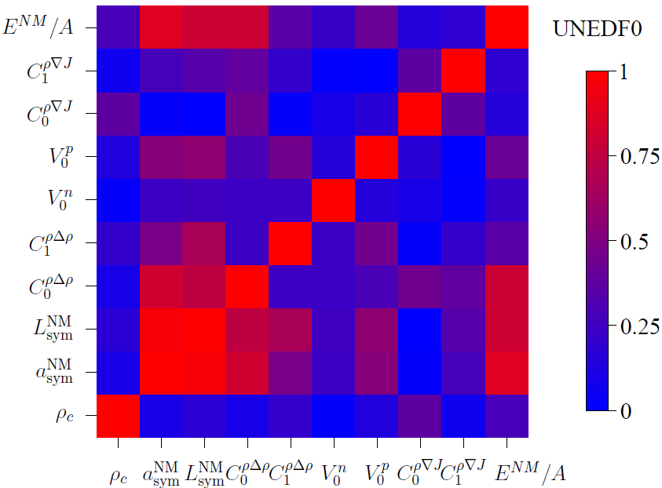
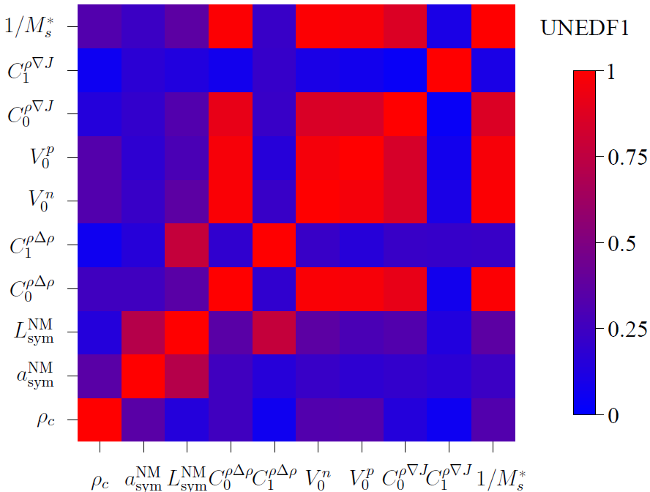
Parameter correlations
Graphical representation of correlation matrix:
|R_{ij}| = 1 : full correlation
|R_{ij}| = 0 : independent parameters |R_{ij}| < 0.8 no significant correlation
Shift of correlations from nuclear matter properties to pairing/spin-orbit/sp
Does it mean that bulk properties are (more or less) under control?

Slide 16
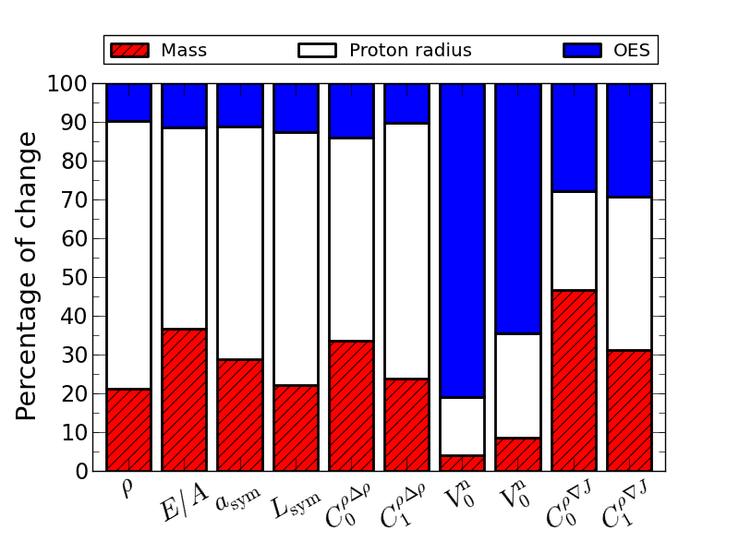
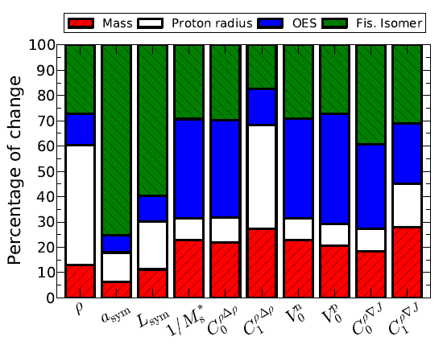
Sensitivity of parameters to datatype
Percentage of change of parameter under a global change of all data of a certain type (masses, radii, OES)0
Huge contribution from the 4 isomers (30% variation induced by 2% of data)
Isoscalar C^{ρΔρ}: shift from proton radius to OES
Relative weakening of OES dependence of pairing strengths

Slide 17
How sensitive to specific data?
Look at average change in parameters when specific experimental data changes
Small fluctuations = UNEDF1 as well-constrained as UNEDF0
x
⁵⁶Ni
²⁰⁸Pb
⁴⁰Ca

Slide 18
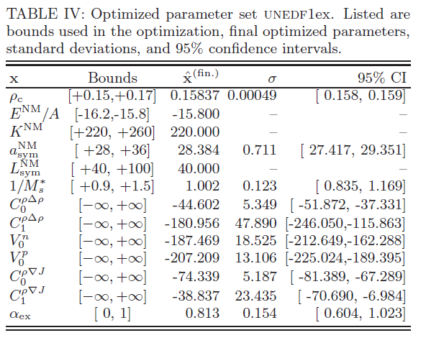
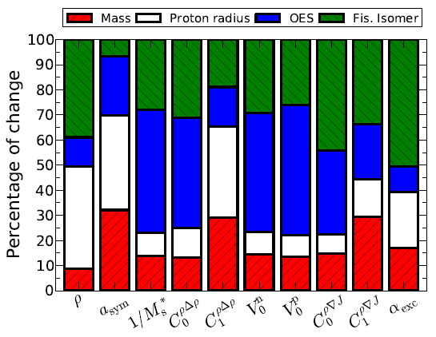
Playing with Coulomb exchange
Screening the exchange Coulomb to simulate many-body effects: adding a scaling parameter α
Final χ₂ similar to the un-screened case : data insufficient to constrain it
Huge variations in dependence of a_{sym} with respect to different data types

Slide 19
Conclusions
UNEDF1:
A few more data points (7)
A new type of data: fission isomer excitation energy
No center-of-mass correction
Overall quality similar as UNEDF0, with big improvement for fission
Very strong dependence on fission isomer excitation energies: can we really live without states at large deformation?
Toward UNEDF2:
Adding spin-orbit couplings in doubly-magic nuclei
Blocking calculations required for sp energies
Giant dipole resonances
Neutron drops
Releasing tensor coupling constants to have the full Skyrme-like functional

