Slide 1
TDSLDA Today and the Road Ahead
Aurel Bulgac
Collaborators: Ionel Stetcu (Seattle)
Yuan-Lung (Alan) Luo (Seattle)
Piotr Magierski (Warsaw/Seattle)
Kenneth J. Roche (PNNL/Seattle)
Yongle Yu (Wuhan)
Sukjin Yoon (Seattle, now at APCTP)
Funding:
US DOE: DE-FG02-97ER41014 , DE-FC02-07ER41457, DE-AC05-760RL01830
Polish Ministry of Science: N N202 128439
P.R. China: NSF-11075201 , NKBRSF-2011CB921503
Computing:
Athena UW Cluster
Hyak UW cluster, NSF MRI grant PHY-0922770
Franklin, Cray XT4, US DOE NERSC, grant B-AC02-05CH11231
JaguarPF, Cray XT5, US DOE NCCS, grant DEAC05-00OR22725

Slide 2
In 2006 we promised to implement SLDA/TDSLDA with no symmetry restrictions
as an accurate alternative to QRPA for all nuclei (A>16). Here we are now:
we developed: the extension of DFT to superfluid systems: (A)SLDA
“ the extension of SLDA to time-dependent phenomena: TDSLDA
“ the appropriate accurate numerics for both SLDA and TDSLDA
we implemented SLDA/TDSLDA on leadership class supercomputers with massive
parallelization, fast I/O, checkpoint/restart, extensive use of the latest advanced visualization
techniques for the analysis of results and their presentation
(the nuclear code is  1,000-2,000 more complex than any existing TDHF code)
we have used cca 70M+ CPU hours on Jaguar PF in 2010 and 5M+ CPU hours on
Hopper in 2011
we established a very accurate relation between ab initio QMC results and the energy
density functional for the unitary Fermi gas, which was amply confirmed by experiments
we demonstrated the ability to calculate: collective spectra of open shell nuclei, nucleon
scattering and capture/knockout, nuclear fission, a limited (so far) number of nuclear reactions
we revealed a number of new qualitative physics phenomena:
superfluid flow at supercritical phenomena
Higgs-Anderson modes, shock waves, dark solitons/domain walls
generation of vortices, vortex rings and their real-time dynamics
the first simulation of the vortex crossing and reconnection and the incipient phases
of quantum turbulence in a fermionic superfluid

Slide 3
Capabilities of the SLDA/TDSLDA suite of codes:
(extensively documented in: J. Phys.: Conf. Ser. 125, 012064 (2008),
Joule DOE metric report for FY 2010, SOM of Science, 332,1288 (2011) )
full 3D simulations with no symmetry restrictions
number of coupled nonlinear PDEs for ²³⁸U = 546,512
describe both closed-shell and open-shell systems of arbitrary shapes
correct description of all spurious modes (translation, rotation, gauge invariance)
wave functions are accurately represented on a 3D spatial lattice
(for ²³⁸U 40²x64 = 60²x80 fm³ for a lattice constant 1.25 fm)
high numerical accuracy for spatial derivatives using FFTW
for TD high-accuracy and numerically stable 5th order predictor-corrector-modifier algorithm with only 2 evaluations of the rhs per time step and with no matrix operations
full diagonalization of Hermitian matrices 409,600x409,600 on JaguarPF (for ²³⁸U)
performance:
Static: ins/wall-time = 1.37e19/18,393= 7.46e14, flops/wall-time=9.42e16/18,393= 5.12e13
PEs = 217,800
TD: ins/wall-time = 7.11e17/2,031= 3.50e14, flops/wall-time= 1.89e16/2,031= 0.93e13
PEs = 136,628
excellent weak and strong scaling
very fast I/O and checkpoint/restart capabilities
nuclear volumes (so far) of the order of (L = 40 to 80 fm)³, larger volumes possible
in such volumes one can describe cca 42,000 neutrons at saturation density
capable of simulating up to times of the order of 10⁻¹⁸ s (a few million time steps)
codes written in Fortran90, with many components in C

Slide 4
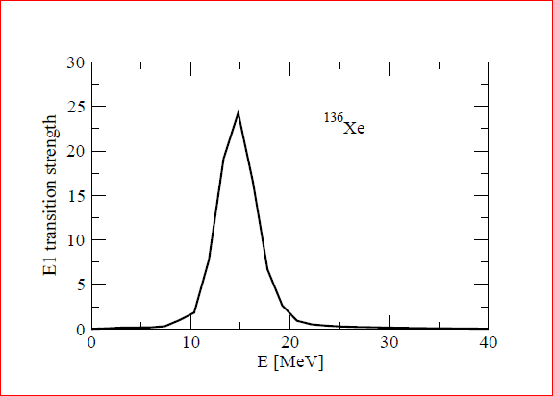
Isovector dipole strength computed in TDSLDA with SLy4
I. Stetcu et al.

Slide 5
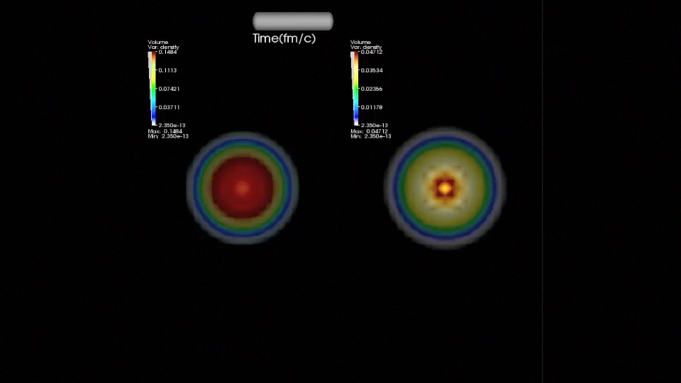
Coulomb excitation of GDR with a relativistic heavy-ion computed in TDSLDA
I. Stetcu et al.
Movie

Slide 6
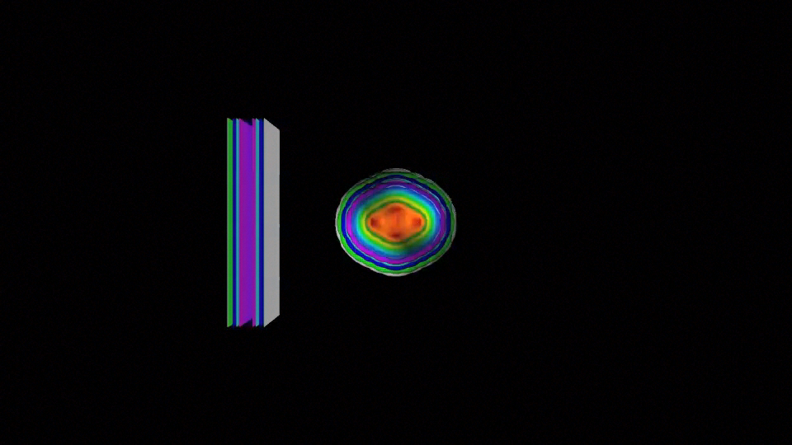
Neutron scattering of ²³⁸U computed in TDSLDA
I. Stetcu et al.
Movie

Slide 7
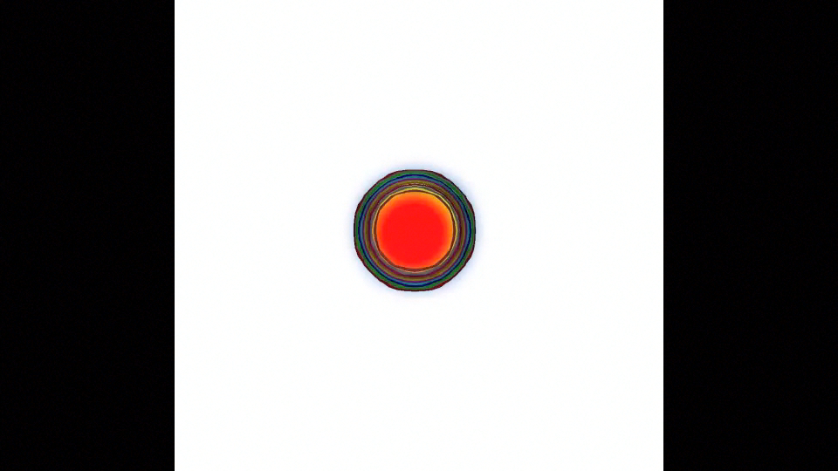
Real-time induced fission of ²⁸⁰Cf computed in TDSLDA
I. Stetcu et al.
Movie

Slide 8
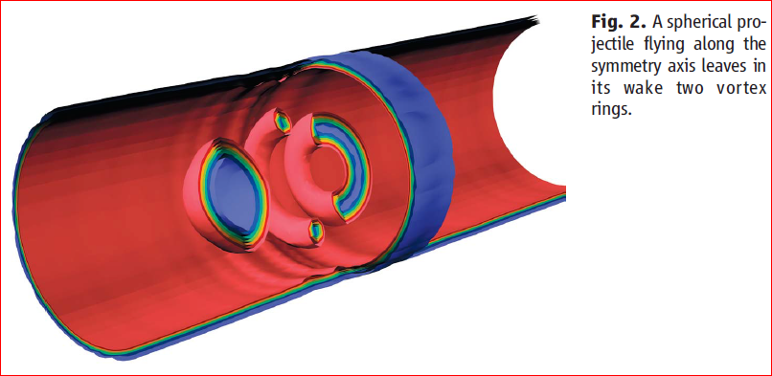
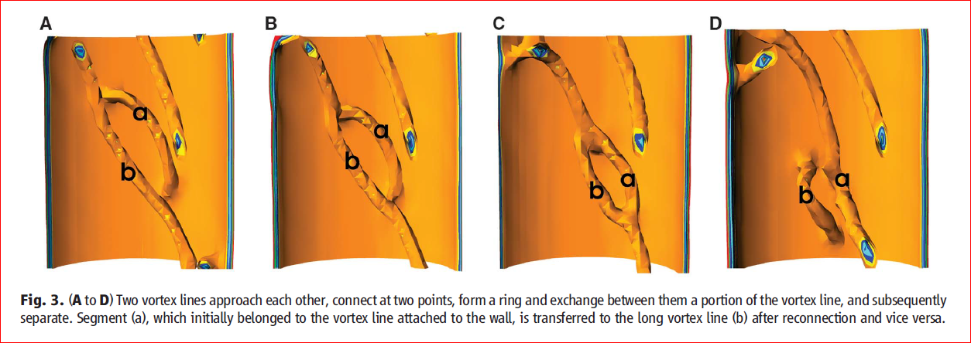
A. Bulgac, Y.-L. Luo, P. Magierski, K.J. Roche, Y. Yu
Science, 332, 1288 (2011)

Slide 9
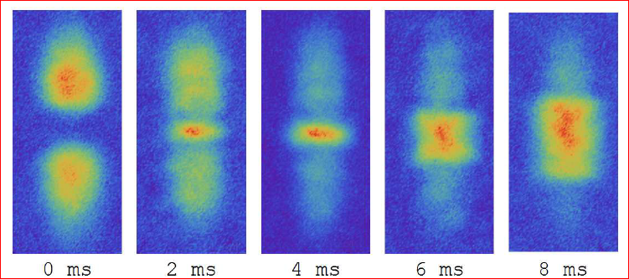
Observation of shock waves in a strongly interacting Fermi gas
J. Joseph, J.E. Thomas, M. Kulkarni, and A.G. Abanov PRL 106, 150401 (2011)
Number density of two colliding cold Fermi gases in TDSLDA

Slide 10
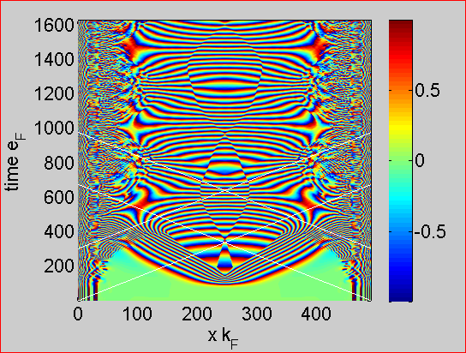
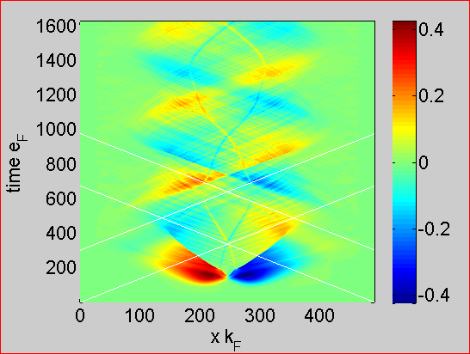
Dark solitons/domain walls and shock waves in the collision of two UFG clouds
Phase of the pairing gap normalized to 
Local velocity normalized to Fermi velocity

Slide 11
Why we need exascale and the extension of the TDSLDA to
the Stochastic TDSLDA?

Slide 12
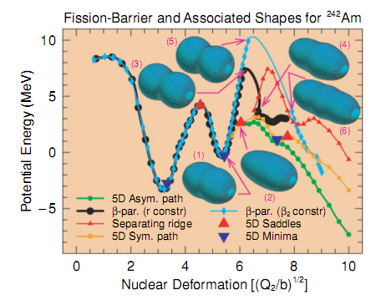
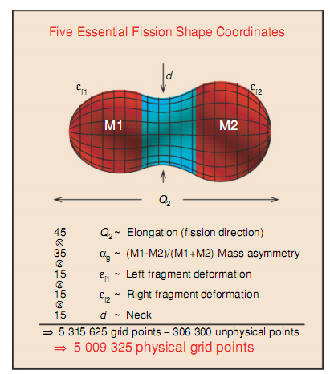
Nuclear LACM and fission studies using a GCM type of many-body wave function:
P. Moller and collaborators need more than 5,000,000 shapes in a five dimensional space.
P.Moller et al. Phys. Rev. C 79, 064304 (2009)
Why this is inadequate? (just a few reasons)
Many more collective degrees of freedom needed, theoretical accuracy hard to quantify
Only one potential energy surface, while many are needed
Inertia tensor difficult to calculate, ambiguous prescriptions
Adiabaticity is definitely violated, unclear how to describe dissipation within LACM
Theory becomes impractical (even at exascale) for many collective degrees of freedom

Slide 13
We need to consider the generic situation with multiple
potential energy surfaces.
Energy
Deformation

Slide 14
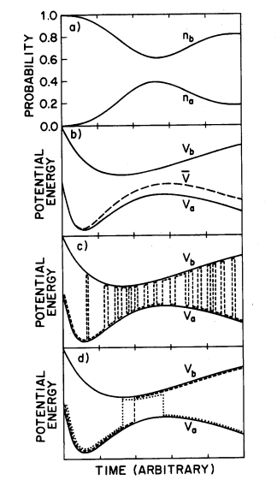
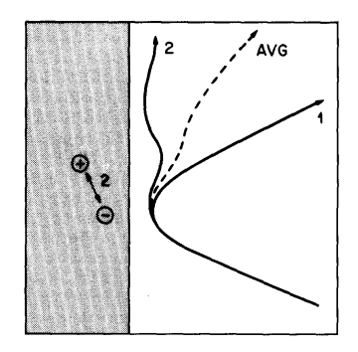
John C. Tully suggested the following recipe for condensed matter
and chemistry applications
J. Chem. Phys. 93, 1061 (1990)

Slide 15
Evolution operator of an interacting many-body system
(after a Trotter expansion and a Hubbard-Stratonovich transformation)
This representation is not unique, the one-body evolution operator is arbitrary!!!
Kerman, Levit, and Troudet, Ann. Phys. 148, 443 (1983)
This looks much worse that the infamous
fermion sign problem!!!

Slide 16
What we need is a bit more complicated, to simulate dynamics along
the Keldysh-Schwinger complex time-ordered contour
Initial state preparation
(equilibrium at finite T)

Slide 17
Here is how this can be done and has already been implemented numerically
on Hyak-UW (MRI-NSF funded cluster, Intel chips, 1120 cores, 3Gb RAM/core)
We place several fermions on a square lattice
NB The coordinate and momentum creation/anihilation operators are linked by the
usual unitary transformations.
We evolve an initial many-fermion wave function using independent real-time path integral representations of the propagators for the bra (backward in time) and ket (forward in time) many-body wave functions:
We used both discrete and continuous HS transformations, and simulated up to 6 fermions.

Slide 18
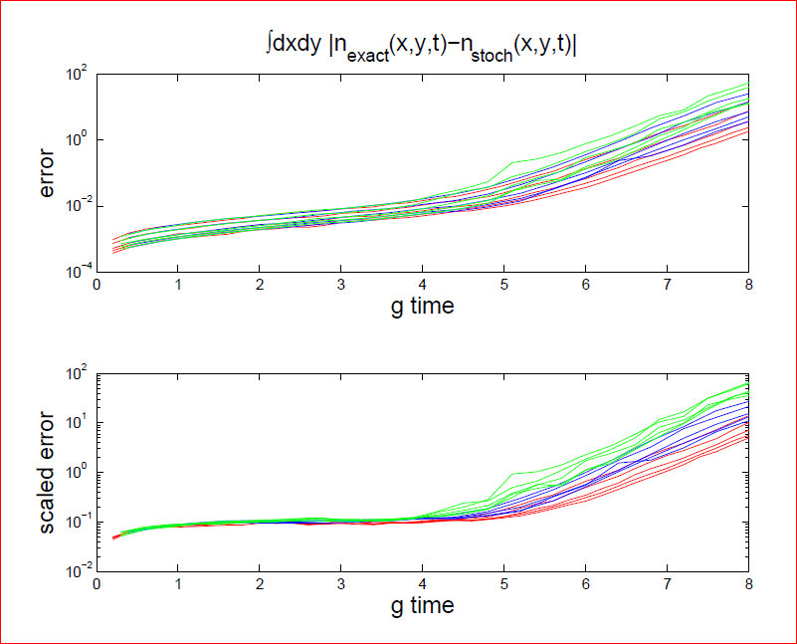
Results for two fermions, for g=1 (red), 2 (blue), and 3 (green), and a 16x16 lattice
Sample sizes for the propagator M= 2,500, 5,000, 10,000 and 20,000.
Lower plot shows that error scales as theoretically expected

Slide 19
Theoretical analysis and further numerical simulations show that for
N interacting fermions the simulation error behaves as
NB The error is independent of:
the dimensionality of the space
the spatial volume/size of lattice
a relatively small number of samples is needed for a decent
accuracy

Slide 20
What we could in principle be able to calculate?
We do not need to determine any collective coordinates, potential energy
surfaces, inertia tensor, non-abelian gauge fields, etc. as the system will find
naturally the right collective manifold
We will not need to assume either isentropic, isothermal, … meanfield solutions.
Instead the temperature and entropy of the collective subsystem will evolve according
to the rules of QM. This will be the most natural framework to describe dissipation
in collective nuclear motion.
We should be able to compute directly the mass, charge distributions and the
excitation energy, and maybe even quantum number distributions of each fragment
We should be able to follow in real time a real experimental situation,
such as induced fission or fusion
This kind of simulations will answer in particular real needs of national security/nuclear forensics
New theoretical techniques however would allow us to address new types of theoretical questions, in particular we would be able to study, with quantifiable theoretical errors, very fast non-equilibrium processes in strongly interacting many-fermion systems
All this is naturally not limited to nuclear physics alone, this is a general approach to solve a large class of many-body problems numerically exactly, with quantifying errors, within the next decade … or sooner.

Slide 21
Plans for the next few years:
Improve performance and numerical accuracy of the codes, study alternative numerical methods, improve the treatment of the absorbing boundary conditions, extend calculations to larger nuclear simulation volumes and longer times)
Systematic calculations of collective states in nuclei across the periodic table (likely new collaboration with K. Nakatsukasa and his colleagues)
Perform real-time calculations of excitation of nuclear reaction with neutrons
and excitation of nuclei with gamma rays
Simulate the excitation of single, double and triple GDR with relativistic heavy ions (new collaboration with C. Bertulani, GSI experiment)
Simulate the induced nuclear fission with relativistic heavy ions (new collaboration with C. Bertulani, GSI experiment)
Simulate the dynamics of vortices in neutron star crust and attempt to finally elucidate the pinning mechanism of vortices and their role in starquakes (new collaboration with S. Reddy)
Study the dissipation in spontaneous fission by simulating the real-time dynamics of a fissioning nucleus from the scission point onward
Extend/apply TDSLDA approach to nuclear reactions
Further studies of the UFG
Vigorously pursue the Stochastic extension of TDSLDA and prepare the grounds for doing nuclear physics in the exascale regime (new collaborations envisioned with G.F. Bertsch, M.M. Forbes, S. Moroz, …)

Slide 22
Computational and Computer Science needs:
Next three years between 100-200 M CPU hours/year
3-5 years 1-20 billion CPU hours/year (assuming the 10-100 petascale regime)
5-7 and after 20-200 billion CPU hours/year (assuming the exascale regime)
Likely we will need to perform a large number of calculations in extended
precision
We will vigorously examine the use of GPUs (K.J. Roche + S. Cohen (postdoc))

Slide 23
Quantum Monte Carlo for nuclei on the lattice with EFT interactions and pions
(new collaboration with J.E. Drut, M.M. Forbes, S. Moroz, …)
3D lattice techniques were initially introduced and extensively tested (Bulgac, Drut,
Magierski) for finite temperature QMC calculations and we simulated successfully systems
with up to about 100 fermions
We have predicted a large number of various observable and their dependence on coupling
constant and temperature (EOS, critical temperature, phase transitions, high-momentum
distribution, quasi-particle spectrum, pairing gap and the pseudogap phase, etc.) many of
which have been accurately confirmed in subsequent experiments
We have already developed parallel codes capable of simulating systems in lattice sizes in
principle up to 100³ (tested so far 20³ on Hyak)
We plan to simulate even-even nuclei with N=Z up to A=100, as well as neutron matter and
symmetric nuclear matter as in these systems the fermion sign problem is expected to be
rather benign
In lattices 32³ and above the numerical accuracy should be at the level of a 2-3 % or lower
and this approach should become competitive with NCSM and CC
Following the approach pioneered by Epelbaum, Krebs, Lee and Meissner,
PRL 106, 192501 (2011) we envision to be able to calculate both ground states as well as
excited states properties in these nuclei with a much finer and larger spatial lattice
Likely these methods should allow for extension to system with 1 and 2 nucleons
above the N=Z even-even core.

