Slide 1
The role of simulations in science and innovation
David J. Dean
Senior Advisor
Office of the Under Secretary for Science
Department of Energy
UNEDF 2011, June 20-24, 2011
A
EXASCALE
C S
R C

Slide 2
Outline
Energy
Energy’s affect on climate
Simulations and energy/competitiveness
The future of simulations
Thoughts on UNEDF and SciDAC-III

Slide 3
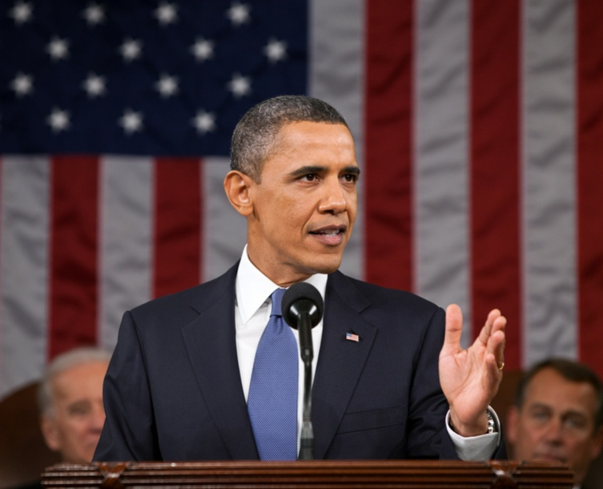
Our Generation’s Sputnik Moment
  “This is our generation's Sputnik moment. Two years ago, I said that we needed to reach a level of research and development we haven't seen since the height of the Space Race.
  …[this] budget to Congress helps us meet that goal. We'll invest in biomedical research, information technology, and especially clean energy technology—an investment that will strengthen our security, protect our planet, and create countless new jobs for our people.”
Remarks of President Barack Obama
State of the Union Address to the Joint Session of Congress
Tuesday, January 25, 2011

Slide 4
CO₂ emissions and GDP per capita
Source: DOE EIA database (2008)
Russia data 1992-2005, Germany data 1991-2005

Slide 5
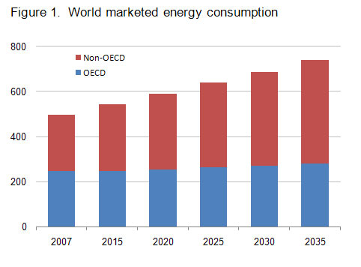
International Energy Outlook 2010 (EIA) – Reference Case
+84%
+14%

Slide 6
US Energy Production and Usage 2009 ( 94.6 Quads)
Source: Lawrence Livermore National Laboratory and the Department of Energy,
Energy Information Administration, based on data from DOE/EIA-0384(2009),August 2010).

Slide 7
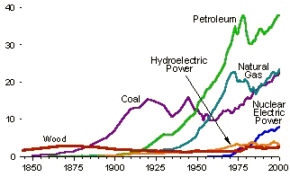
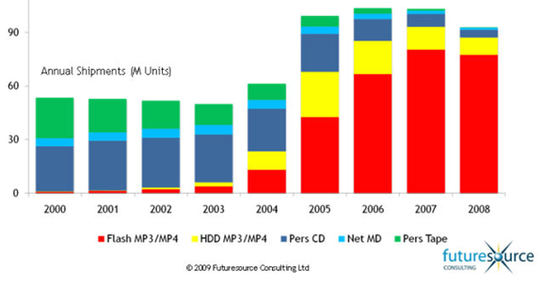
Energy is Different
ENERGY:
Ubiquity – consider economic, social and political costs
Longevity – Stock of existing assets
Scale – large capital assets and access to existing infrastructure
Incumbency – New technologies compete on cost
U.S. energy supply
since 1850
Source: EIA
Consumer electronics
ELECTRONICS:
Demand structural features allow rapid learning
  Multiple units
  Smaller capital cost
  More rapid turnover
Demand responds to the right signals
  Perceived price
  Standards
  Behavior
Sales of Personal
Audio/Video since 2000

Slide 8
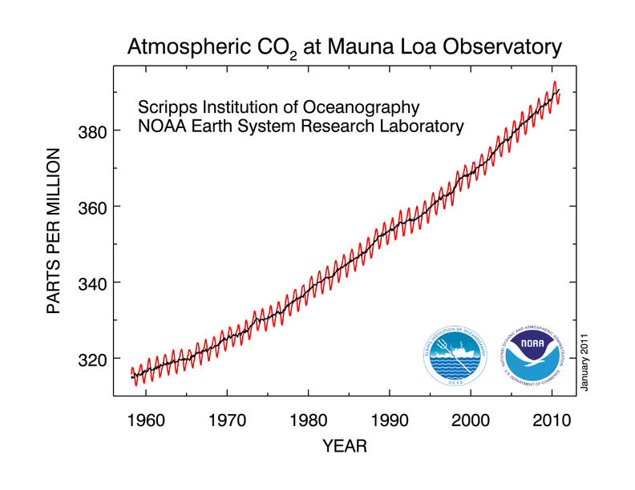
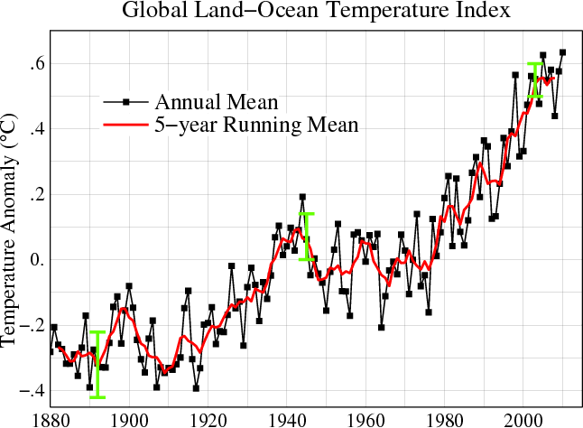





Observed CO₂ and global temperature
Non-renewable energy production generates CO₂ and affects the climate
Source: http://www.giss.nasa.gov
Many Reports written on this subject

Slide 9
Simulations that make a difference
Simulations
Increase physical understanding
Decrease time from discovery to deployment
Play important role in energy problems

Slide 10
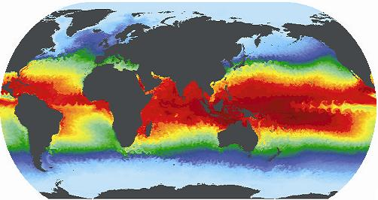
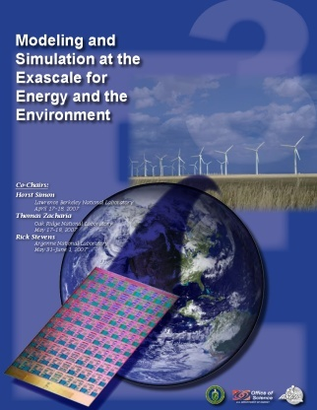


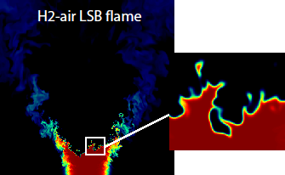
Building the case for simulations –
Extreme Scale Workshops – focus on Science Applications
Town Hall Meetings April-June 2007
Scientific Grand Challenges Workshops November 2008 – October 2009
  Climate Science (11/08)
  High Energy Physics (12/08)
  Nuclear Physics (1/09)
  Fusion Energy (3/09),
  Nuclear Energy (5/09) (with NE)
  Biology (8/09)
  Material Science and Chemistry (8/09),
  National Security (10/09) (with NNSA)
Cross-cutting workshops
  Architecture and Technology (12/09)
  Architecture, Applied Mathematics and Computer Science (2/10)
Meetings with industry (8/09, 11/09)
External Panels
  ASCAC Exascale Charge (FACA, 2010)
  Trivelpiece Panel (2010)
MISSION IMPERATIVES
FUNDAMENTAL SCIENCE

Slide 11
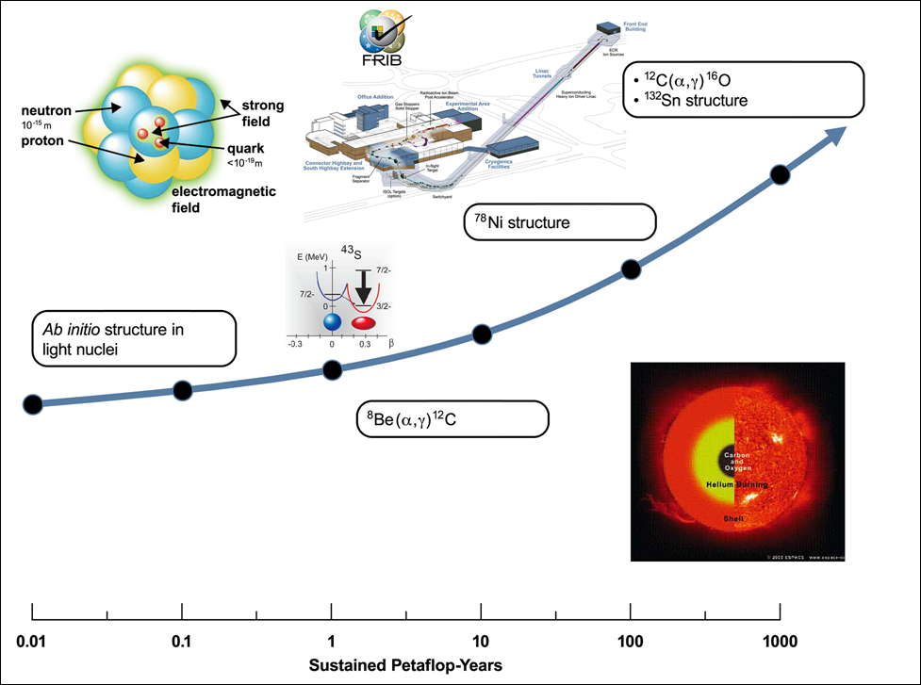
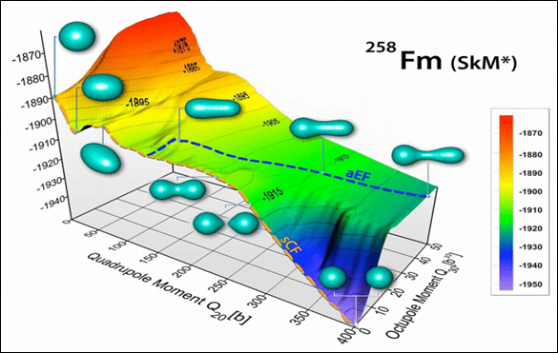
Nuclear Physics Simulations for scientific discovery
TD-HFB fission for hot nuclei

Slide 12
An average of 2 decades from discovery to commercialization
1930
1940
1950
1960
1970
1980
1990
2000
Teflon
Lithium-ion batteries
Velcro
Titanium production
Polycarbonate
Diamond-like thin films
GaAs
Predictive capability is key to accelerating the innovation cycle
Amorphous soft magnets
After Gerd Ceder (MIT); materials data from T. W. Eagar and M. King, Technology Review 98 (2), 42 (1995)
Notes:
12

Slide 13
Simulations: Early impacts
 | Innovation | Impact
Boeing | Predictive optimization of airfoil design | 7-fold decrease in testing
Cummins | New engine brought to market solely with modeling and analysis tools | Reduced development time and cost; improved engine performance
Goodyear | Predictive modeling for new tire design | 3-fold reduction in product development time
Ford | Virtual aluminum casting | Estimated 7:1 return on investment; $100M in savings
GE/P&W | SBES for accelerated insertion of materials in components | 50% reduction in development time, increased capability with reduced testing
Simulations have demonstrated significant improvements in product development cycles across several industry sectors
Notes:
13

Slide 14
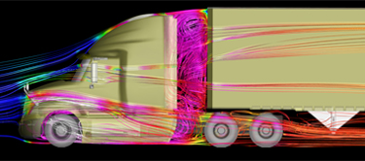
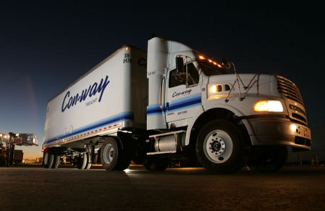
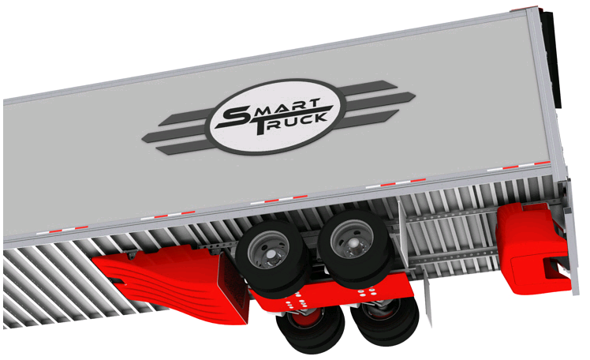






High Performance Computing: SmartTruck/DOE Partnership
Aerodynamic forces account for ~53% of long haul truck fuel use.
Class 8 semi trucks (300,000 sold annually) have average fuel efficiency of 6.7 MPG
Used ORNL’s Jaguar Cray XT-5 2.3 petaflop computer for complex fluid dynamics analysis – cutting in half the time needed to go from concept to production design
Outcome: SmartTruck UnderTray add-on accessories predict reduction of drag of 12% and yield EPA-certified 6.9% increase in fuel efficiency.
If the 1.3 million Class 8 trucks in the U.S. had these components, we would save 1.5 billion gallons of diesel fuel annually (~$4.4B in costs and 16.4M tons of CO₂)
Awarded as one of the “Top 20 products of 2010” from Heavy Duty Trucking magazine
Con-way Freight Inc. is the first corporation to install the SmartTruck UnderTray system.
Notes:
ORNL’s Jaguar helps BMI win award, nation save fuel (DOE press release)
OAK RIDGE, Tenn., Feb. 8, 2011 – A BMI Corp. SmartTruck technology that could save 1.5 billion gallons of diesel fuel and $5 billion in fuel costs per year has hit the road in record time in part because of simulations performed on the nation’s most powerful supercomputer at the Department of Energy’s Oak Ridge National Laboratory.
While South Carolina-based BMI Corp. has just won an industry award from Heavy Duty Trucking magazine, the real winners could be trucking companies and the environment. With installation of BMI’s SmartTruck UnderTray System to improve the aerodynamics of 18-wheeler (Class 8) long-haul trucks, the typical big rig can achieve fuel savings of between 7 and 12 percent, easily meeting the new California Air Resources Board mandate that calls for a minimum mileage improvement of 5 percent.
Those results, which earned BMI one of the publication’s top 20 products of the year awards, were made possible because of simulation work performed on ORNL’s Jaguar supercomputer.
“We were able to run simulations based on the most complex tractor and trailer models instead of simplified models, and we were able to run them faster,” said Mike Henderson, chief executive officer and founder of BMI, an engineering services firm based in Greenville, S.C.
The work on Jaguar shortened the computing turnaround time for BMI’s complex models from days to a few hours and eliminated the need for costly and time-consuming physical prototypes. In all, running simulations on Jaguar allowed BMI to go from concept to a design that could be turned over to a manufacturer in 18 months instead of the 3½ years they had anticipated, according to Henderson, who noted, however, that more work remains.
“Our first goal was to design add-on parts for existing trucks and trailers to make them more aerodynamic,” Henderson said. “By reducing drag we boost fuel efficiency and cut the amount of carbon that’s being dumped into the environment.”
In time, BMI plans to design trucks that are far more aerodynamic from the ground up.
“We hope to soon turn our attention to creating a brand new highly aerodynamic vehicle with optimum fuel efficiency,” Henderson said.
Until then, Henderson noted that if all of the nation’s 1.3 million Class 8 trucks were configured with just the minimum UnderTray package, the average fuel economy of 6 miles per gallon could increase to about 6.5 mpg or more, which is significant given the fact 18-wheelers collectively travel some 130 billion miles per year. And from an emissions standpoint, equipped with the aerodynamics package, those trucks would reduce their carbon dioxide emissions by 32.7 billion pounds (16.4 million tons).
BMI’s work with ORNL was made possible through the laboratory’s Industrial High-Performance Computing Partnerships Program, supported by the DOE Office of Science. Through this effort, BMI was able to access Jaguar, which boasts nearly 225,000 processing cores with a theoretical peak computational capability of 2.3 petaflops (2.3 quadrillion floating operations per second).
The UnderTray’s aerodynamic components are manufactured in Georgia by Cellofoam while various metal brackets, bolts and other hardware that attach the parts to the trailer are made by a number of companies in South Carolina. Several fleets, including Con-way Truckload and Frito-Lay, are already using the parts. The kit can be installed in the field by fleet owners and operators.
The award is to be presented today at the American Trucking Association’s 2011 Technology & Maintenance Council’s annual truck show in Tampa, Fla. UT-Battelle manages ORNL for DOE’s Office of Science.

Slide 15
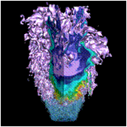
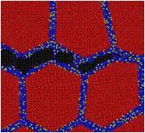
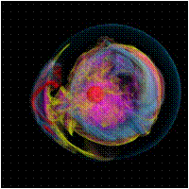
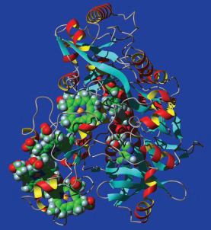
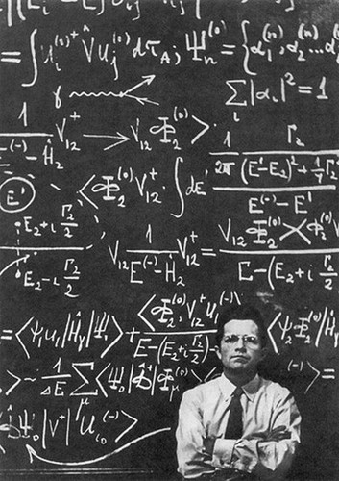
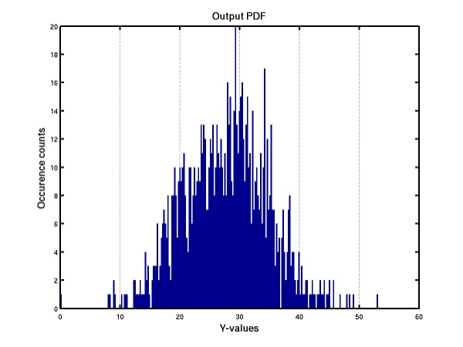
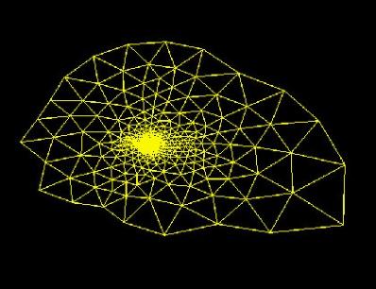
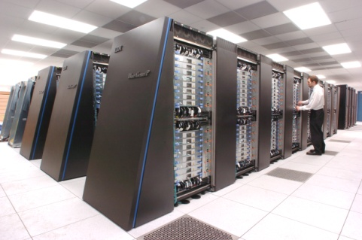
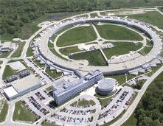
Simulations requires interlocking framework
Problem to Solve
System
V&V framework and UQ
Algorithms
Models
Software
Hardware
Math
Vertical Integration is a good paradigm

Slide 16
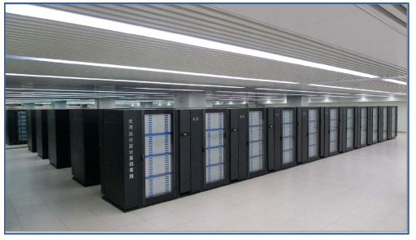
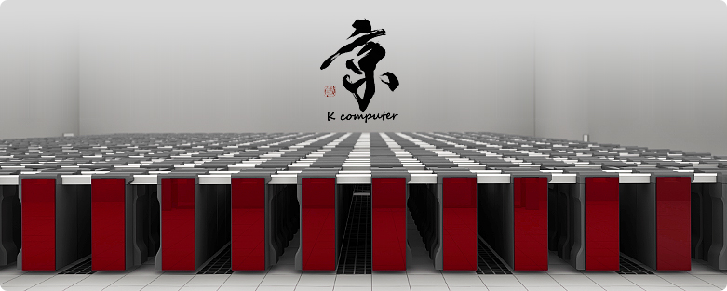
The world scene is changing rapidly
Tianhe-1A
China (10/28/10)
  US chips, Chinese interconnect
  2.51 PF Linpack result
Japan (6/20/11)
  K computer – 8.162 PF
  Fujitsu (Spark64’s)
“The United States led the world’s economies in the 20th century because we led the world in innovation. Today, the competition is keener; the challenge is tougher; and that is why innovation is more important than ever. It is the key to good, new jobs for the 21st century.“ --President Barack Obama, August 5, 2009

Slide 17
Peta Scale has arrived: World-wide pursuit of Peta-scale computing
Rank | June 2011 (Location) | Linpack Speed (PF) | Rank | November 2010 (Location) | Linpack Speed (PF) | Rank | June 2010 (Location) | Linpack Speed (PF)
1 | K (Japan) | 8.162 | 1 | Tianhe-1A (China) | 2.566 | 1 | Jaguar (ORNL) | 1.759
2 | Tianhe-1A (China) | 2.556 | 2 | Jaguar (ORNL) | 1.759 | 2 | Nebulae (China) | 1.271
3 | Jaguar (ORNL) | 1.759 | 3 | Nebulae (China) | 1.271 | 3 | Roadrunner (LANL) | 1.042
4 | Nebulae (China) | 1.271 | 4 | Tsubame 2.0 (Japan) | 1.192 | 4 | Kraken (UT/ORNL) | 0.832
5 | GCIC (Tokyo) | 1.192 | 5 | Hopper (LBL) | 1.054 | 5 | Jugene (Germany) | 0.826
6 | Sandia | 1.110 | 6 | Tera-100 (France) | 1.050 | 6 | Pleiades (NASA) | 0.773
7 | NASA/Ames | 1.088 | 7 | Roadrunner (LANL) | 1.042 | 7 | Tianhe-1 | 0.563
8 | NERSC | 1.054 | 8 | Kraken (UT/ORNL) | 0.832 | 8 | BG/L (LLNL) | 0.478
9 | CEA (France) | 1.050 | 9 | Jugene (Germany) | 0.826 | 9 | Intrepid (ANL) | 0.459
10 | Roadrunner (LANL) | 1.042 | 10 | Cielo (LANL/SNL) | 0.817 | 10 | Red Sky (SNL/NREL) | 0.434

Slide 18
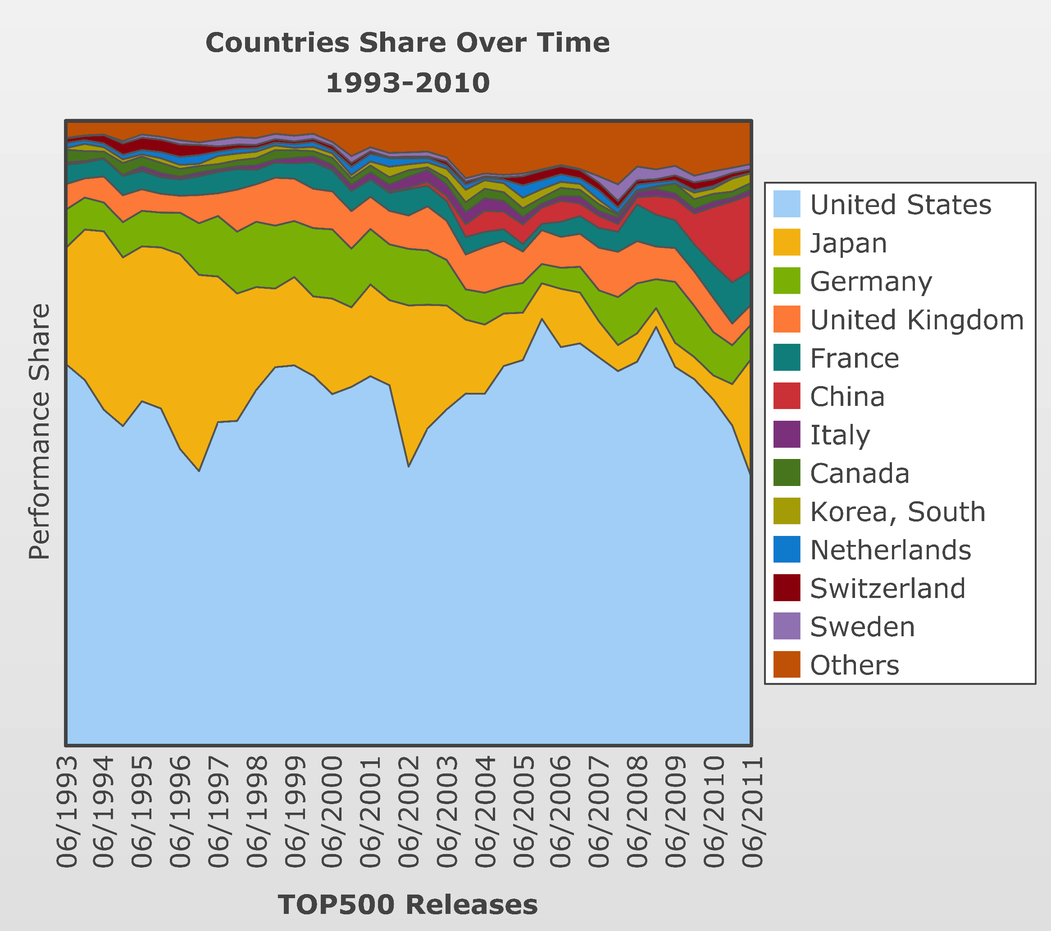
World wide developments

Slide 19
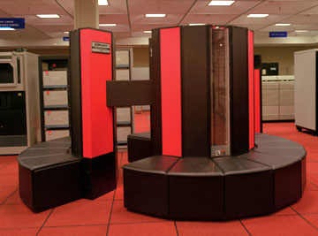
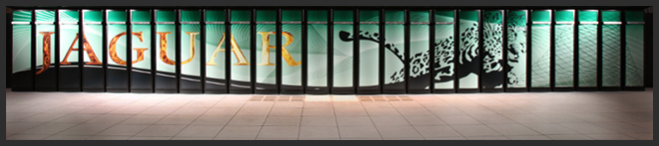
Expect rapid change due to power constraints
1986:
X-MP/48 ~220 Mflop sustained
120-150kW (depending on model)
$40M for computer+disks (FY09$)
Factor of 10⁷ in speed
Factor of 18 in power
SC/ASCR:
Jaguar at 1.759 PF (LINPACK)
ORNL; 6.9 MW
ELECTRICITY | Today | Tomorrow
Electricity Cost | $0.1/kW-hr | $0.1/kW-hr
Requirement | 7MW | 21MW
Cost/hour | $700/hour | $2100/hour
Cost/year | $5.6M | $16.8M
“Flops are Free”

Slide 20
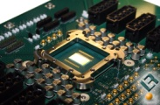
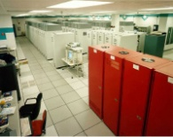
Exascale Program Elements
Platform R&D
Critical Technologies
(everyone benefits)
Software and Environments
Co-design
Platforms
Memory
Nonvolatile storage
Optics
Power
Integration
Risk Mitigation
Operating environment
Systems Software
System reliability
Programming models
Performance models
Simulators
Applications integration with vendors
Early prototypes to ensure component integration and usefulness
Risk mitigation for vendors – Non recoverable engineering cost
Mathematics
Exascale Elements
Today’s capability platform
becomes tomorrow’s desktop

Slide 21
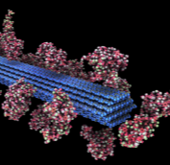
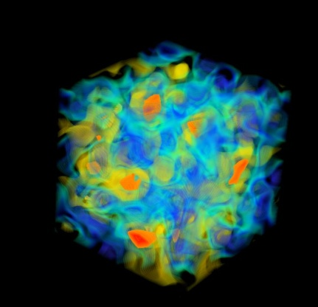
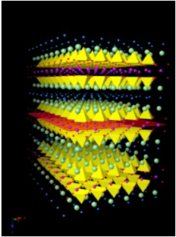
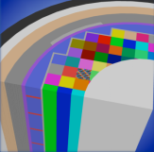
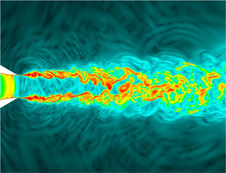
Simulations and Exascale Computing
Computation and simulation advance knowledge in science, energy, and national security
FY12 DOE Exascale Activities will:
Design cost effective, useable, and energy efficient exascale capability by the end of the decade
Support research efforts in applied mathematics and computer science to develop libraries, tools, and software for these new technologies;
Create close partnerships with computational and computer scientists, applied mathematicians, and vendors to develop exascale platforms and codes cooperatively.

Slide 22



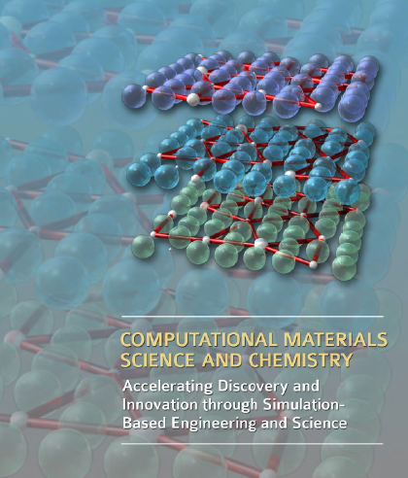
Other (DOE) Activities on Simulation
(it takes time to build a case)
DOE
Simulations Summit
A
EXASCALE
C S
R C
The DOE strategy should be to make simulation part of everyone’s toolbox. At first simulation requires immense parallelism. With the new approaches you have to build software and new hardware concurrently (we learned that at Nvidia) or the software guys won’t know what to do with the hardware. --Steven Chu
FY12 Cross Cut Budget
Justification exercise

Slide 23

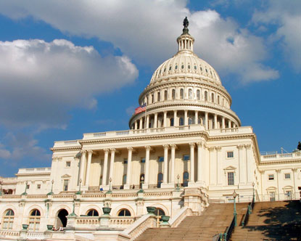
National (US) scene is challenging
Nation and world face same energy and warming issues
Nation faces competitiveness issues
Nation has a big deficit
ARRA helped science → but it’s over
House is flipped → realigned priorities
Senate much tighter → middle ground
Budgets show intent
The next 5-10 years will be lean
How to plan?
  Build on strengths
  Seek opportunity
  Make difficult decisions
  Partner as appropriate
(no earmarks)

Slide 24
What does science do?
Science invests in major efforts that will define the 21st century
  Simulations and exascale computing
  Materials for Clean Energy
  Biology by design
Science provides technical talent to solve difficult problems
Science provides facilities for a broad range of research (including computing)
Science sits at the nexus of discovery and application
The scientific and technical challenges facing the world are substantial and substantive. Let’s get busy.

Slide 25

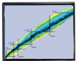
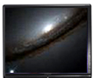
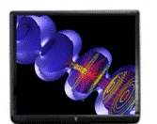

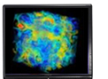
Nuclear Physics and Simulations
(ASCR, NP, HEP, NNSA, BES, and NSF)
Shedding New Light on Exploding Stars ($9.1M, 2001-2005)
SciDAC Center for Supernova Research ($3.7M, 2001-2005)
National Infrastructure for Lattice Gauge Computing ($9.9M, 2001-2005)
Advanced Computing for 21st Century Accelerator
Science and Technology ($8.5M, 2001-2005)
The Particle Physics Data Grid ($15.9M, 2001-2005)
Building a Universal Nuclear Energy
Density Functional ($15M, 2006-2011)
Computational Astrophysics Consortium:
Supernovae, Gamma Ray Bursts, and
Nucleosynthesis ($9.5M, 2006-2011)
The Secret Life of Quarks ($11M, 2006-2011)
Sustaining and Extending the Open Science Grid ($30.5M, 2006-2011)
Community Petascale Project for Accelerator
Science ($14M, 2007-2012)
$127M of leveraged programmatic investment over 10 years

Slide 26
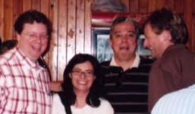
Thoughts on UNEDF
Exciting model for leveraging larger community
  Science:
    SC/NP (rare nuclei; nuclear interaction)
    NNSA (nuclear reactions and fission)
  Challenging Applied Math and computer science
  load balancing; sparse matrix eigen solves; global minimization; non-linear solves
  Focus on HPC and Science → Useful Petascale Apps
Great for recruiting (NNSA)
  Sophia Quaglioni
  Nicholas Schunk
  Ian Thompson
  …

Slide 27
NP Budget Perspective
UNEDF was successful
FOA is still being worked on (ASCR+NP, +NNSA?); reduced levels of funding across the board
SciDAC-III:
  Is not equivalent to Exascale (co-design efforts); but is on the path
  Should be based on science one can obtain with 20-50x current performance
  Promises to be HIGHLY competitive
  Likely that UNEDF scope will have to be significantly reduced/refocused
  ANSWER the call
Think about a proposal that builds on success, and also that gives scenarios for scope of work (at different funding levels)
President’s Budget has: $1M in SciDAC for all of NP

Slide 28
SciDAC-III and UNEDF
Possible Landscape
  Light-ion fusion (NIF diagnostics)
  Predictive reactions (NNSA cares)
  Predictive fission
  Nuclear properties far from stability (SC/NP)
  Large sparse matrices; data movement; load balancing; fault tolerant algorithms, UQ…(ASCR)
Reduced funding will mean choices
Good Luck!!

Slide 29
BACKUP

Slide 30
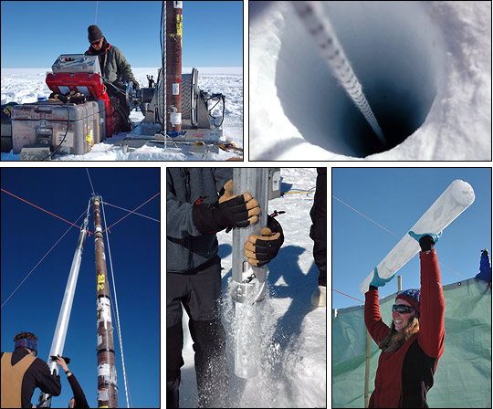
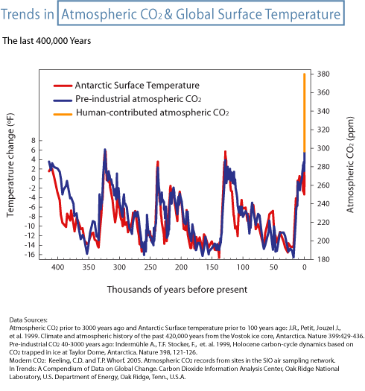
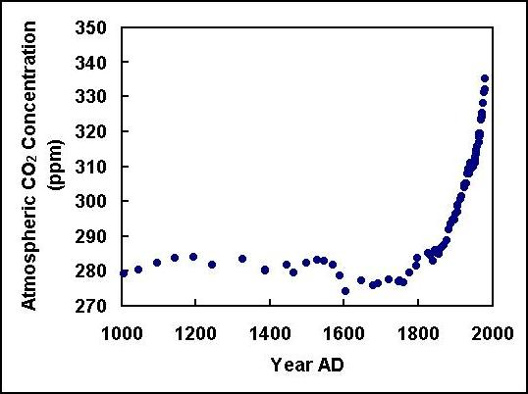
Paleoclimatology

Slide 31
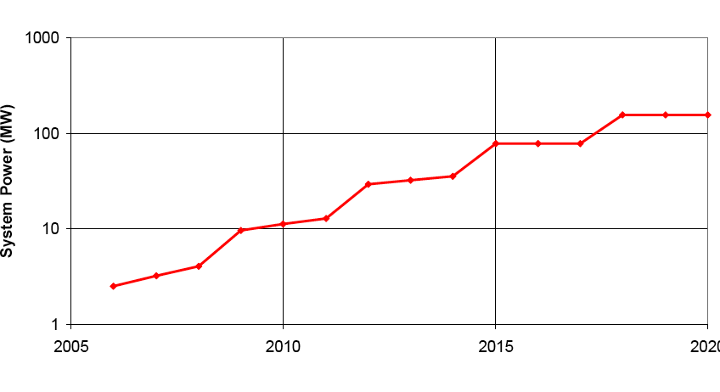
Power Consumption
Barriers
  Power is leading design constraint for computing technology
  Target ~20MW, estimated > 100MW required for Exascale systems (DARPA, DOE)
  Efficiency is industry-wide problem (IT technology >2% of US energy consumption and growing)
Technical Focus Areas
  Energy efficient hardware building blocks (CPU, memory, interconnect)
  Novel cooling and packaging
  Si-Photonic Communication
  Power Aware Runtime Software and Algorithms
Technical Gap
  Need 5X improvement in power efficiency over projections that include technological advancements
Projected including industry BAU improvements
Desired
Possible Leadership class power requirements
From Peter Kogge (on behalf of Exascale Working Group), “Architectural Challenges at the Exascale Frontier”, June 20, 2008
System memory dominates energy budget
Notes:
Slide #8:
Note: clarify that chart at the bottom is an extrapolation of current technology
Note: the gap analysis should be from where we believe the technology will be in a decade (without investment) vs.. (what is necessary for exascale on time, target). That is, the technical gap is not 200-400x, but rather about 6x.
Motivation for each technical challenge - Tie to ExaScale Study
Impact: What does IAA bring to the table that is unique and creates impact?
List of some potential Focus area activities that IAA could initiate

Slide 32
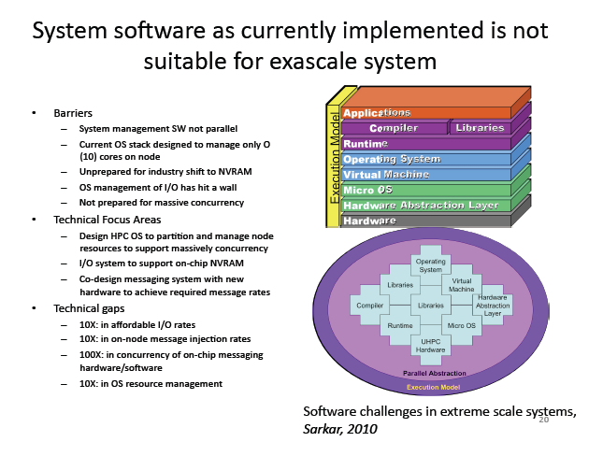
System Software
International Exascale Software Project
(DOE and NSF)

Slide 33
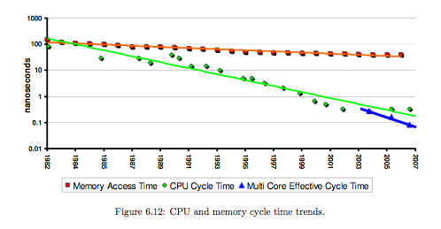
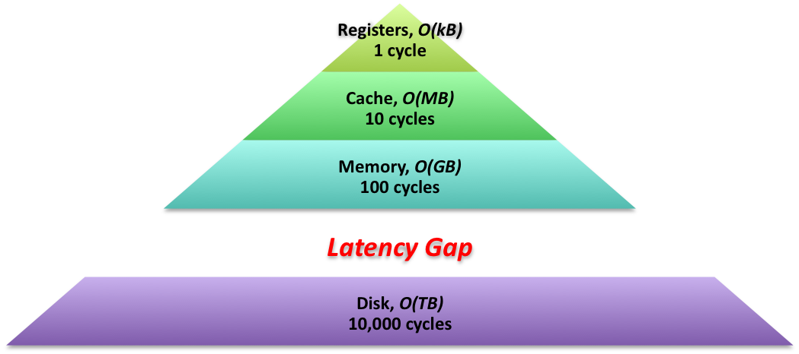
Memory and Storage Bandwidth
Barriers
  Per-disk performance, failure rates, and energy efficiency no longer improving
  Linear extrapolation of DRAM vs. Multi-core performance means the height of the memory wall is accelerating
  Off-chip bandwidth, latency throttling delivered performance
Technical Focus Areas
  Efficient Data Movement
    Photonic DRAM interfaces
    Optical interconnects / routers
    Communications optimal algorithms
  New Storage Approaches
    Non-volatile memory gap fillers
    Advanced packaging (chip stacking)
    Storage efficient programming models (Global Address Space)
Technical Gap
  Need 5X improvement in memory access speeds to keep current balance with computation.
EI Investment
Needed
2009
2011
2013
2015
2017
Notes:
Motivation for each technical challenge - Tie to ExaScale Study
Impact: What does IAA bring to the table that is unique and creates impact?
List of some potential Focus area activities that IAA could initiate
Shift from bus-driven memory architectures to high speed serial signaling between the processor and memory system – makes more efficient use of the pin budget. This shift is driven by chip packaging.
Advanced memory controller – enhancing the buffer on board to support enhanced memory operations

