Slide 1
Report on some of the UNEDF work performed
by the UW centered group
A. Bulgac, Y.-L. (Alan) Luo, P. Magierski, K.J. Roche, I. Stetcu, S. Yoon
J.E. Drut, M.M. Forbes, G. Wlazlowski (none UW UNEDF funded)
See also talks of P. Magierski, K.J. Roche and I. Stetcu

Slide 2
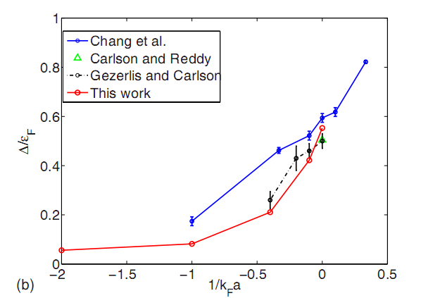
One of the last year’s UNEDF achievements:
Two independent ab initio calculations of the pairing gap in dilute fermion matter

Slide 3
Joaquin also received the 2009 Henderson prize
for the best PhD thesis in the UW Department of Physics

Slide 4
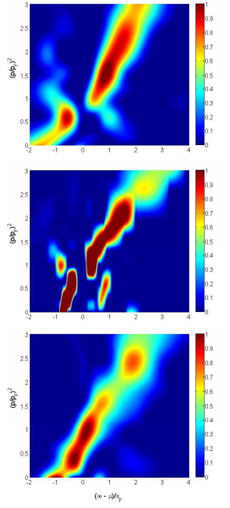
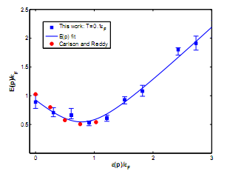
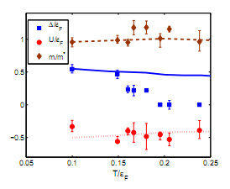
The ab initio calculation of the spectral weight function,
quasi-particle spectrum and its properties at finite T’s.
P. Magierski, G. Wlazlowski, A. Bulgac and J.E. Drut

Slide 5
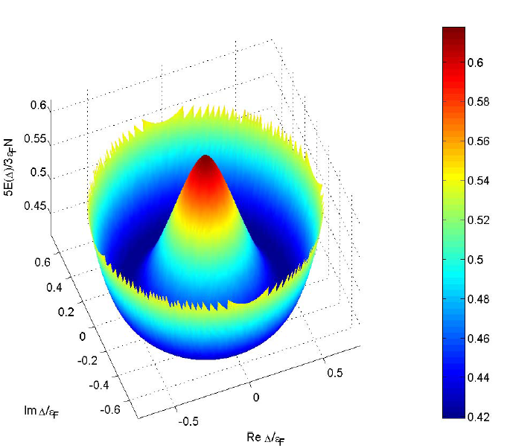
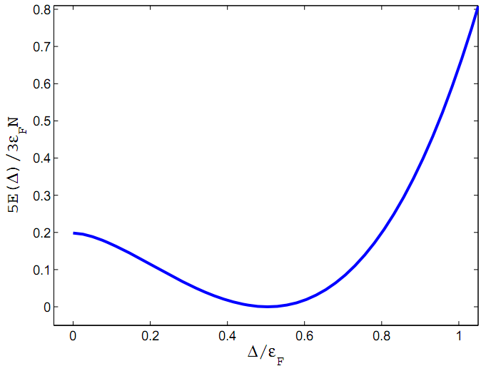
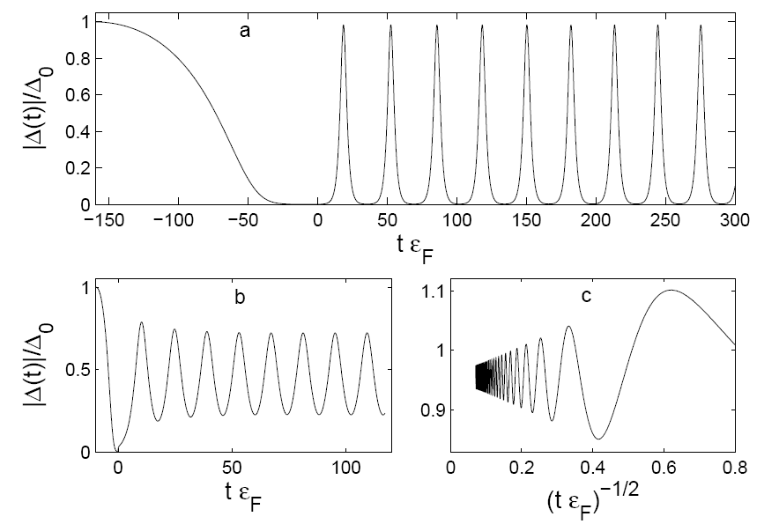
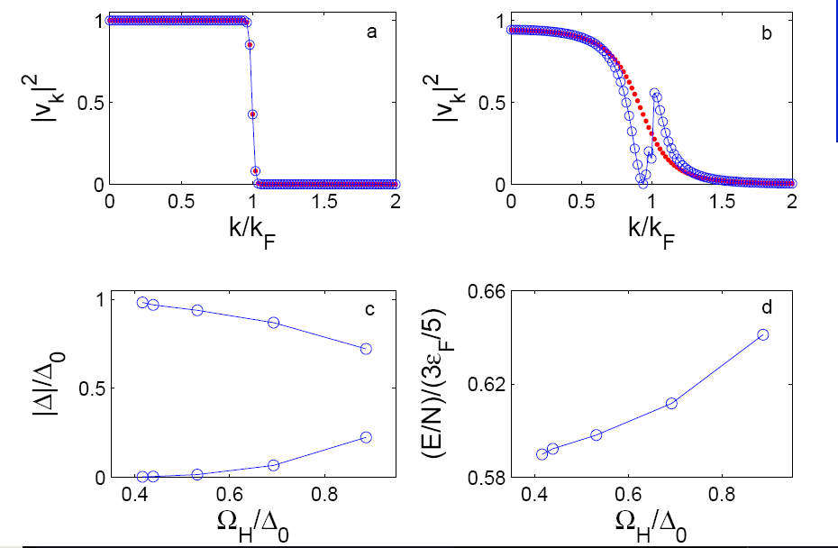
All these modes have a very low frequency below the pairing gap
and a very large amplitude and excitation energy as well
None of these modes can be described either within Quantum Hydrodynamics
or Landau-Ginzburg like approaches
Bulgac and Yoon, Phys. Rev. Lett. 102, 085302 (2009)

Slide 6
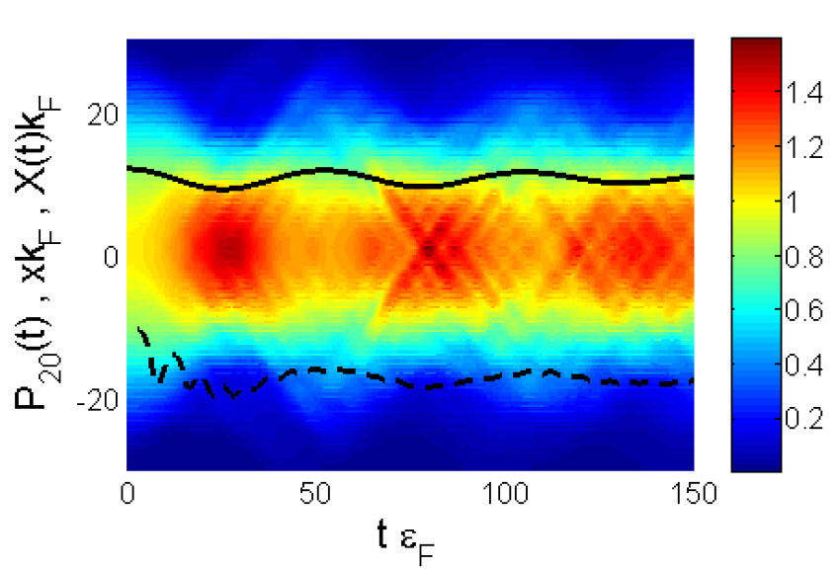
3D unitary Fermi gas confined to a 1D HO potential well (pancake)
New qualitative excitation mode of a superfluid Fermi system
(non-spherical Fermi momentum distribution)
Black solid line – Time dependence of the cloud radius
Black dashed line – Time dependence of the quadrupole moment of momentum distribution
Bulgac and Yoon, Phys. Rev. Lett. 102, 085302 (2009)

Slide 7
Vortex generation and dynamics (Alan Luo)
See movies at
http://www.phys.washington.edu/groups/qmbnt/vortices_movies.html
Ionel Stetcu will show tomorrow night movies of
real time 3D dynamics of superfluid nuclei

Slide 8
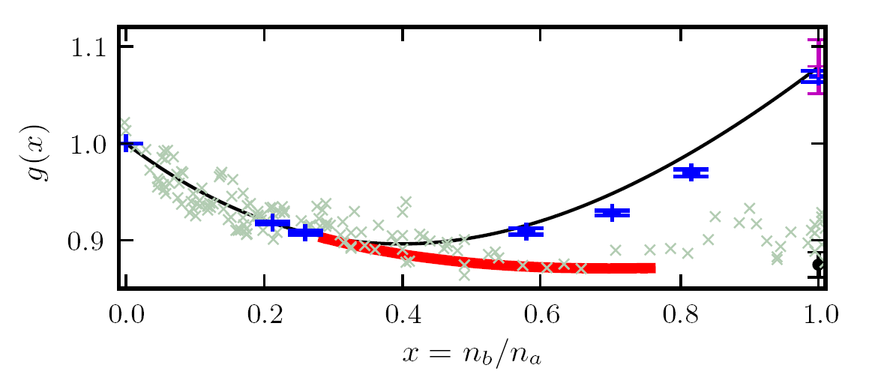
A refined EOS for spin unbalanced systems
Red line: Larkin-Ovchinnikov phase
Black line: normal part of the energy density
Blue points: DMC calculations for normal state, Lobo et al, PRL 97, 200403 (2006)
Gray crosses: experimental EOS due to Shin, Phys. Rev. A 77, 041603(R) (2008)
Bulgac and Forbes,
Phys. Rev. Lett. 101, 215301 (2008)

Slide 9
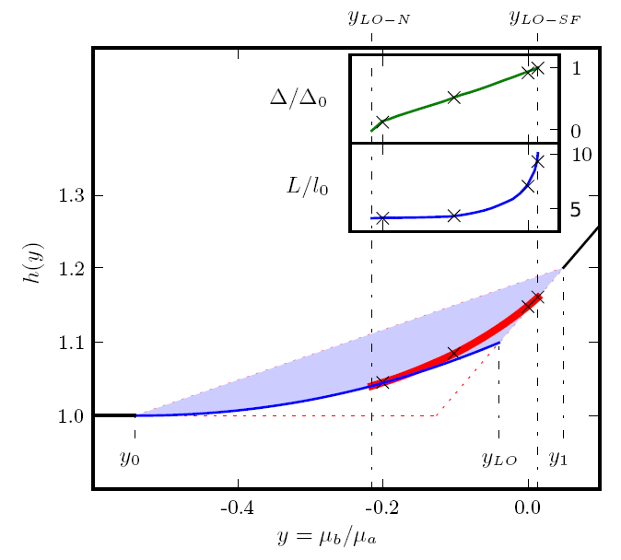
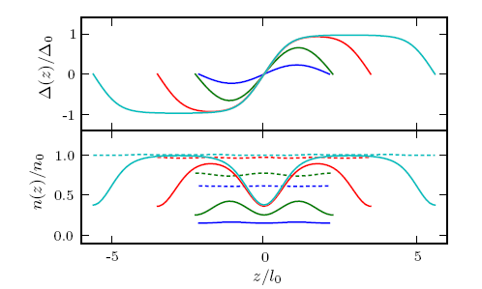
A Unitary Fermi Supersolid:
the Larkin-Ovchinnikov phase
Bulgac and Forbes
Phys. Rev. Lett. 101, 215301 (2008)

Slide 10
Summary of results:
Implemented nuclear version of the TD-SLDA code
Implemented the initial conditions into TD-SLDA, for now from HFBRAD only
Performed extensive testing of the TD-SLDSA code under 1D, 2D and 3D conditions
Parallel version of the code scales essentially perfectly (see talk of Kenny Roche) on
various architectures
Developed a 1D and 2D DVR solvers, and the 3D solver is close to completion (see
talk of P. Magierski)
Established a number of new physical results: Higgs pairing mode in unitary gas,
unitary Fermi supersolid, pseudo-gap (2 published PRLs and one submitted)
Remainder of year 3
Extensive testing of the TD-SLDA code, optimization, generate a C version of the
nuclear code, extensive use of NERSC and ORNL computers
Further optimization (and extension) of 2D and 3D solvers
Apply the TD-SLDA code to a number of physical situations (Coulomb excitation,
Collective states, LACM, Vortex dynamics, …)
Year 4 (and year 5)
Our major challenge is now the generation and implementation of correct and
accurate initial conditions for TD-SLDA code.
Study various EDFs for neutron droplets, dilute fermion systems and nuclear
systems

Slide 11
What aspects of our work require HPC?
2D and 3D solvers, large dense eigenvalue problems
TD-SLDA it will easily fill up Cray XT5 and larger systems
Interest to other physicists
Both (A)SLDA and TD-SLDA are of great to condensed matter studies,
structure and dynamics of neutron star crust, cold atoms, … apart from
relevance to nuclear dynamics
Showcase results?
3D real time nuclear superfluid dynamics
Vortex generation and dynamics in real time in 2D and 3D, emergence of
quantum turbulence, elucidation of the pinning and de-pinning vortex
mechanism

